Slide 1
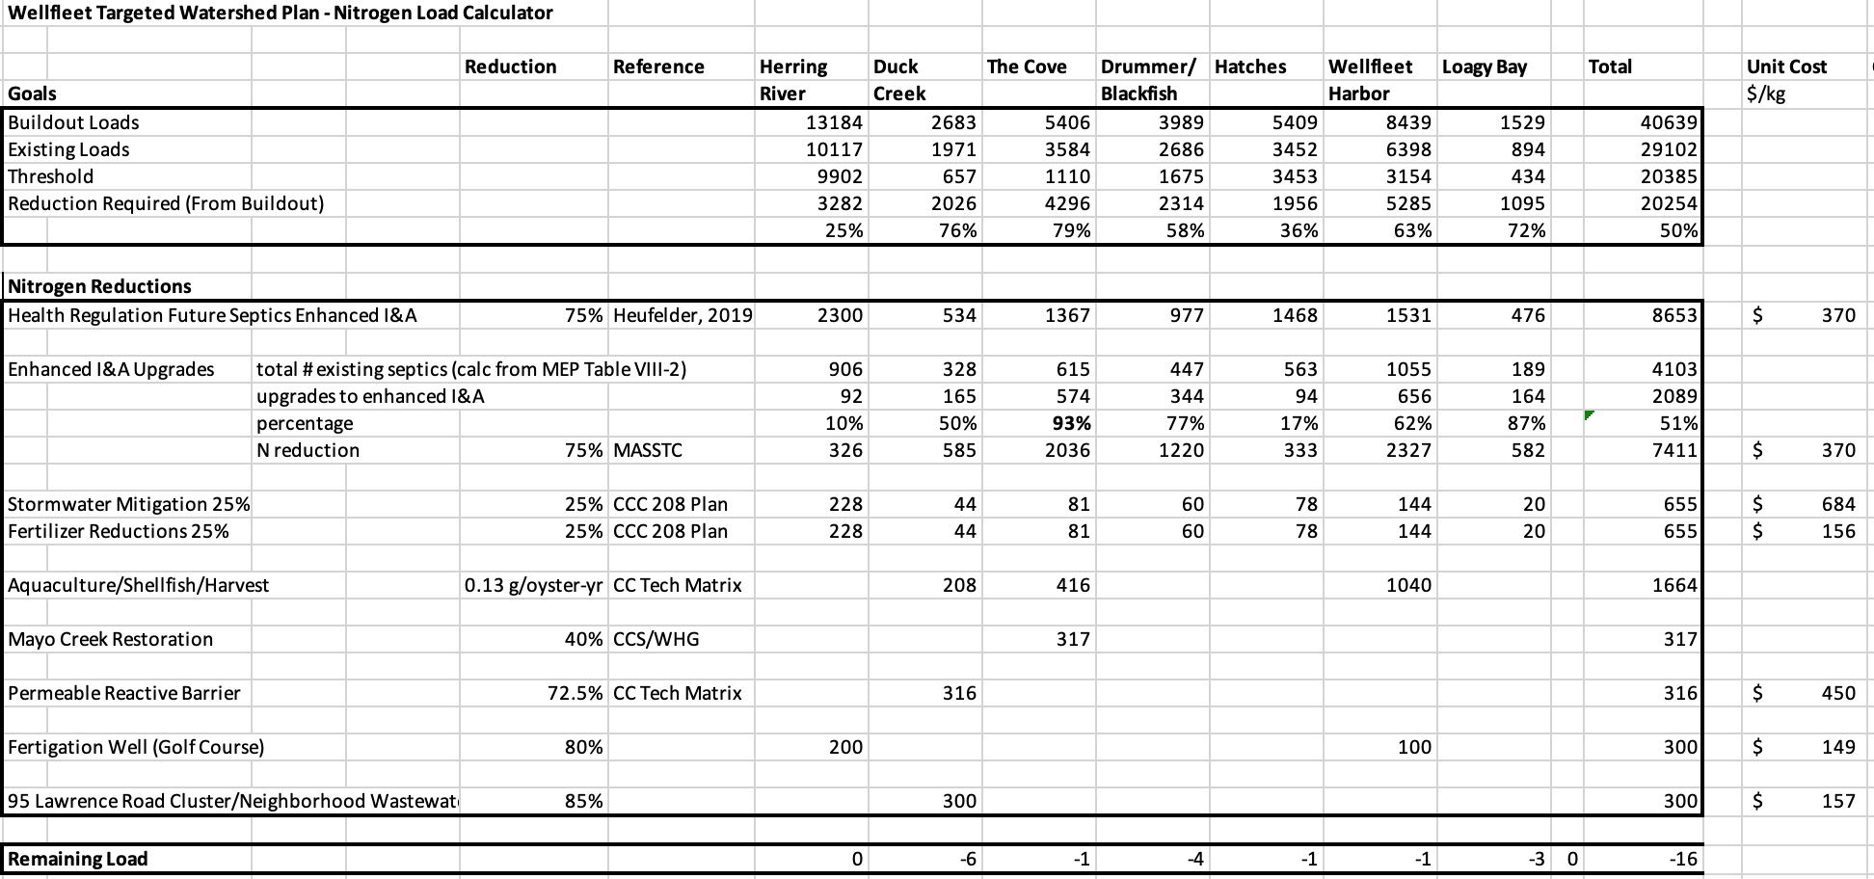

Slide 2
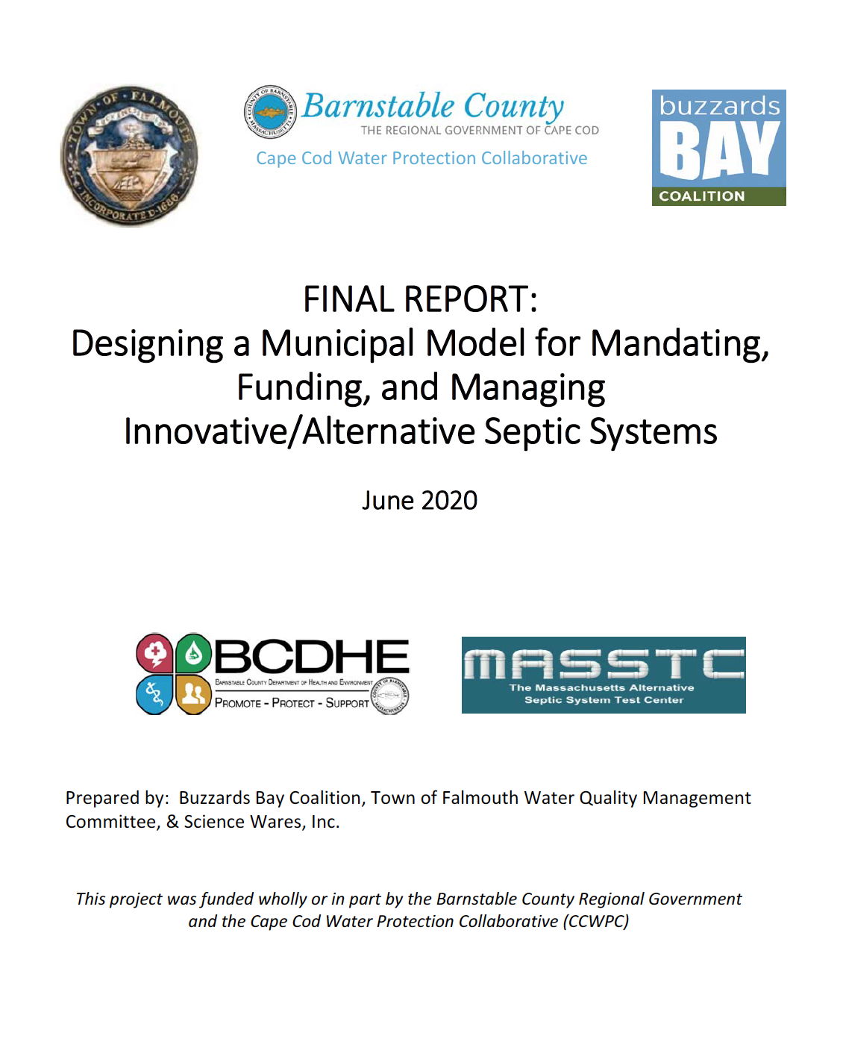

Slide 3
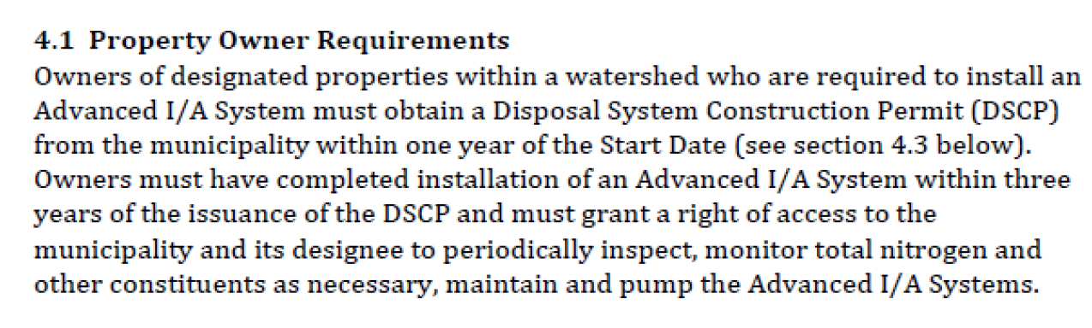
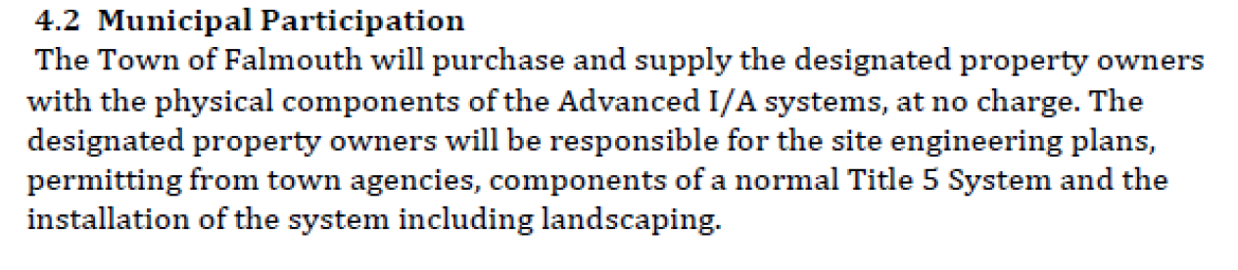
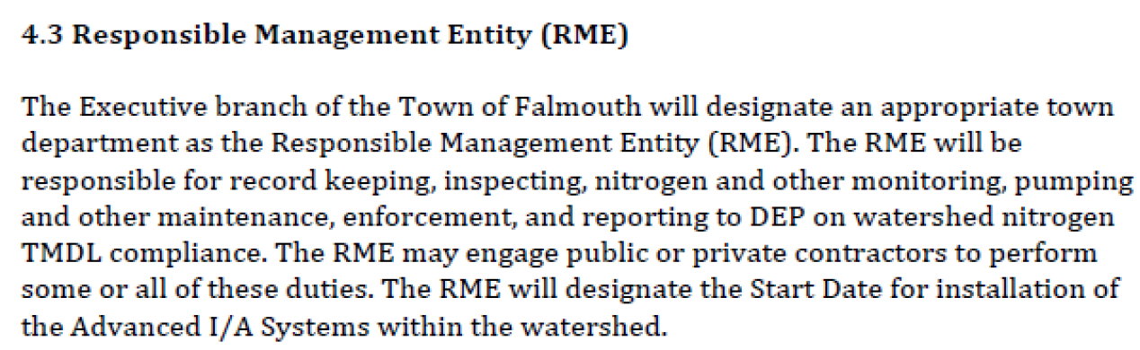

Slide 4
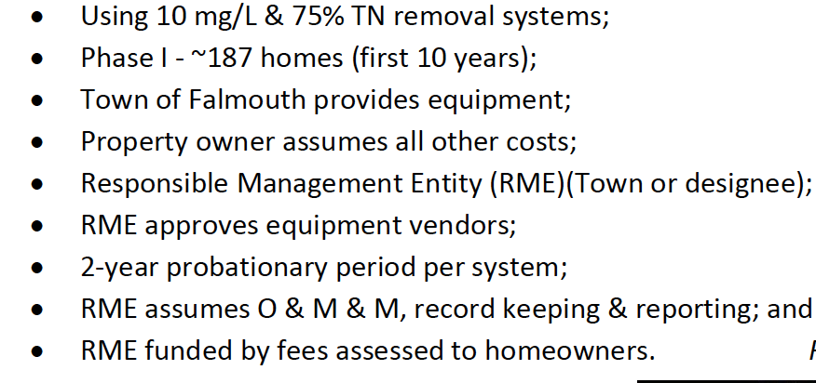
Town of Falmouth Responsible Management Entity (RME) for Enhanced I&A Septics

Slide 5
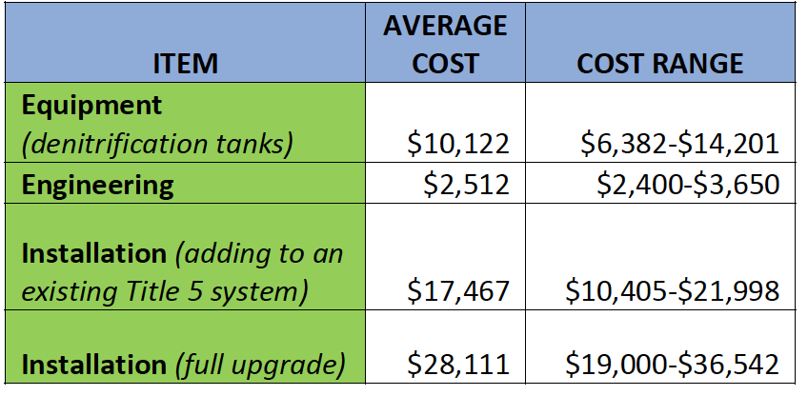
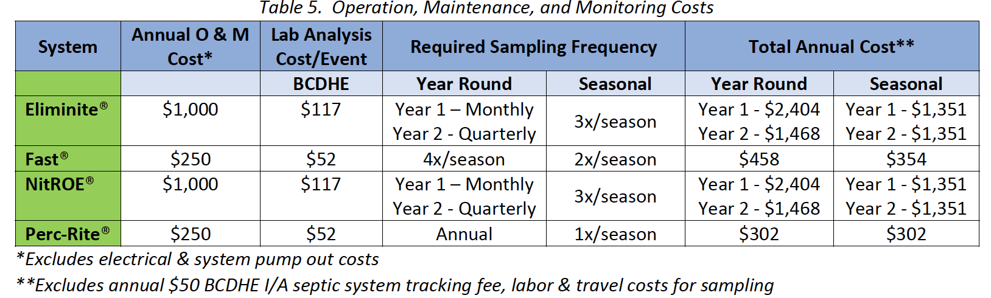

Slide 6
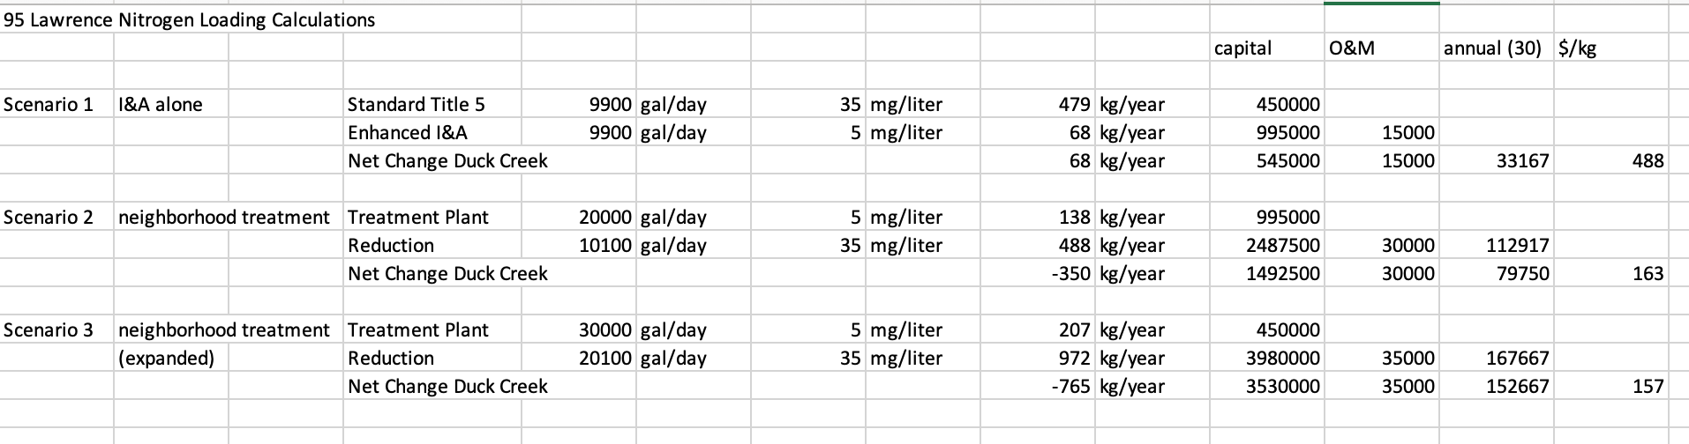

Slide 7
Proposed Health Regulation
608 The use of a nitrogen reducing system is required for all new, repairs, and upgrades within the Wellfleet Harbor Embayment System watersheds as identified by the Massachusetts Estuaries Project (MEP) report (2017). Nitrogen reducing systems are defined as those systems technologies approved by MADEP and rated at 19 mg/liter nitrogen.
609. The Town of Wellfleet provides an incentive program for installations of “enhanced” nitrogen reducing systems. Incentives include a grant and/or tax exemption in the amount of $10,000. Enhance nitrogen reducing systems are defined as those technologies that have average nitrogen effluent concentrations less than 10 mg/liter as demonstrated by third-party testing. Currently the Board of Health recognizes the following technologies as enhanced: NITRO, NITREX, and the sawdust-based system known as the “Layer Cake” technology (Heufelder, 2019). Other technologies may be petitioned by applicants for review by the Board of Health and must present third-party testing data.

