Slide 1
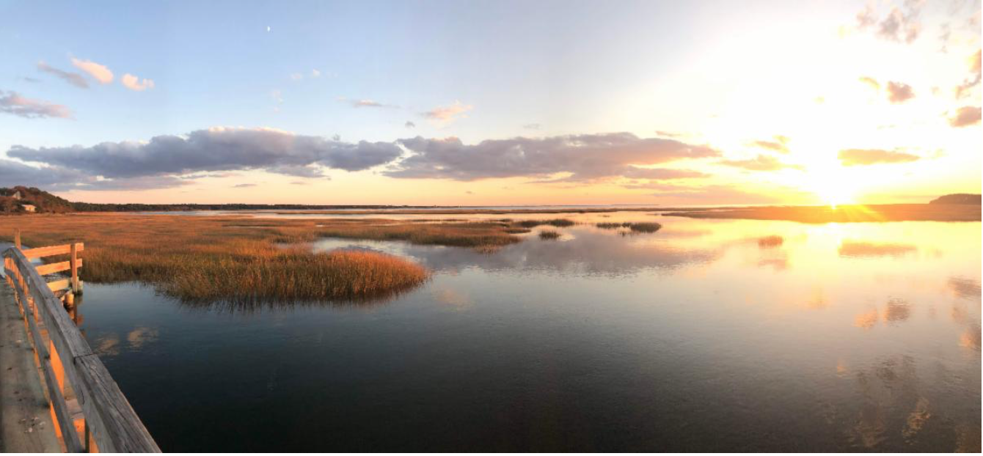
Targeted Watershed Plan
Scott Horsley, Water Resources Consultant
Curt Felix, Chair, Clean Water Advisory Committee

Slide 2
Goals of Targeted Watershed Plan
Restoration of Ecosystems & Water Quality
Compliance with Clean Water Act
Quicker Results (emphasizing in-water and near-water practices)
Focus on Non-Traditional or Nature-Based Solutions
Reduced Costs
Promote Affordable Housing (including accessory dwelling units (ADUs) supported by enhanced I&A septics)
Maximize Local Co-Benefits (including jobs)
Minimize Climate Impacts

Slide 4
Wellfleet Targeted Watershed Plan
Option A |  |  | Option C
Enhanced I&A | 19 - 45 |  | 95 Lawrence | 4.0
95 Lawrence | 4.0 |  | Sewers Town-Wide | 153 - 203
Permeable Reactive Barrier (PRB) | 4.8
Stormwater | 2.0
Salt Marsh Restoration | 1.0
Shellfish | 2.0
TOTAL CAPITAL COST ($M) | 33 - 59 |  |  | 157 - 207
Cost ($/kg) | 59 - 109 |  |  | 305 – 405
Note: Plan is designed to reduce nitrogen loads 20,500 kg/year from full MEP buildout

Slide 5
95 Lawrence
Route 6 Stormwater
PRB
I&A Upgrades

Slide 6
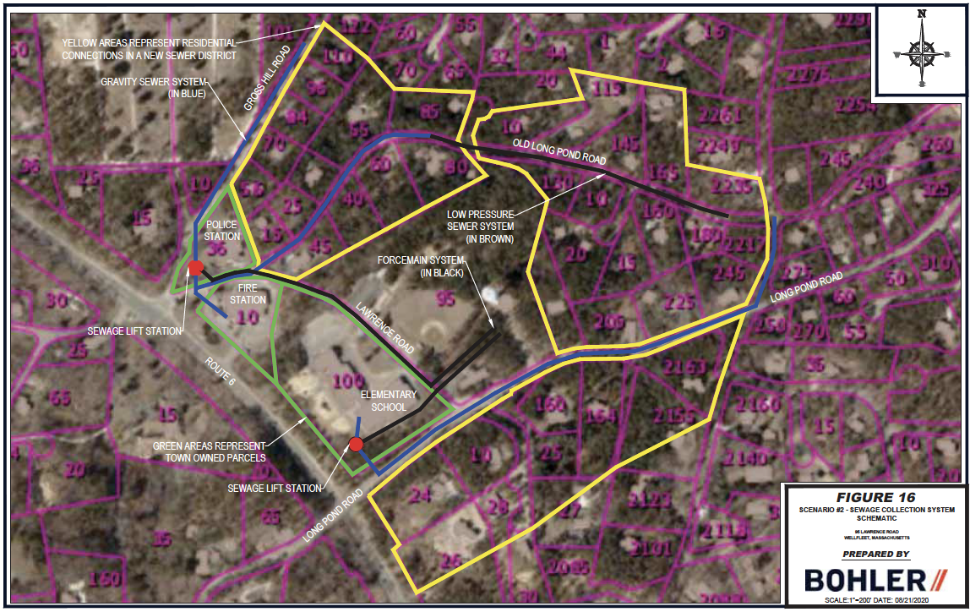
95 Lawrence Road, Wellfleet – Affordable Housing Project with Neighborhood Wastewater Treatment – Net Reduction of up to 1386 kg N/year

Slide 7
Enhanced Innovative and Alternative (I&A) Septic Systems
N Removal 75 – 90%
Similar to Wastewater Treatment Plant

Slide 9
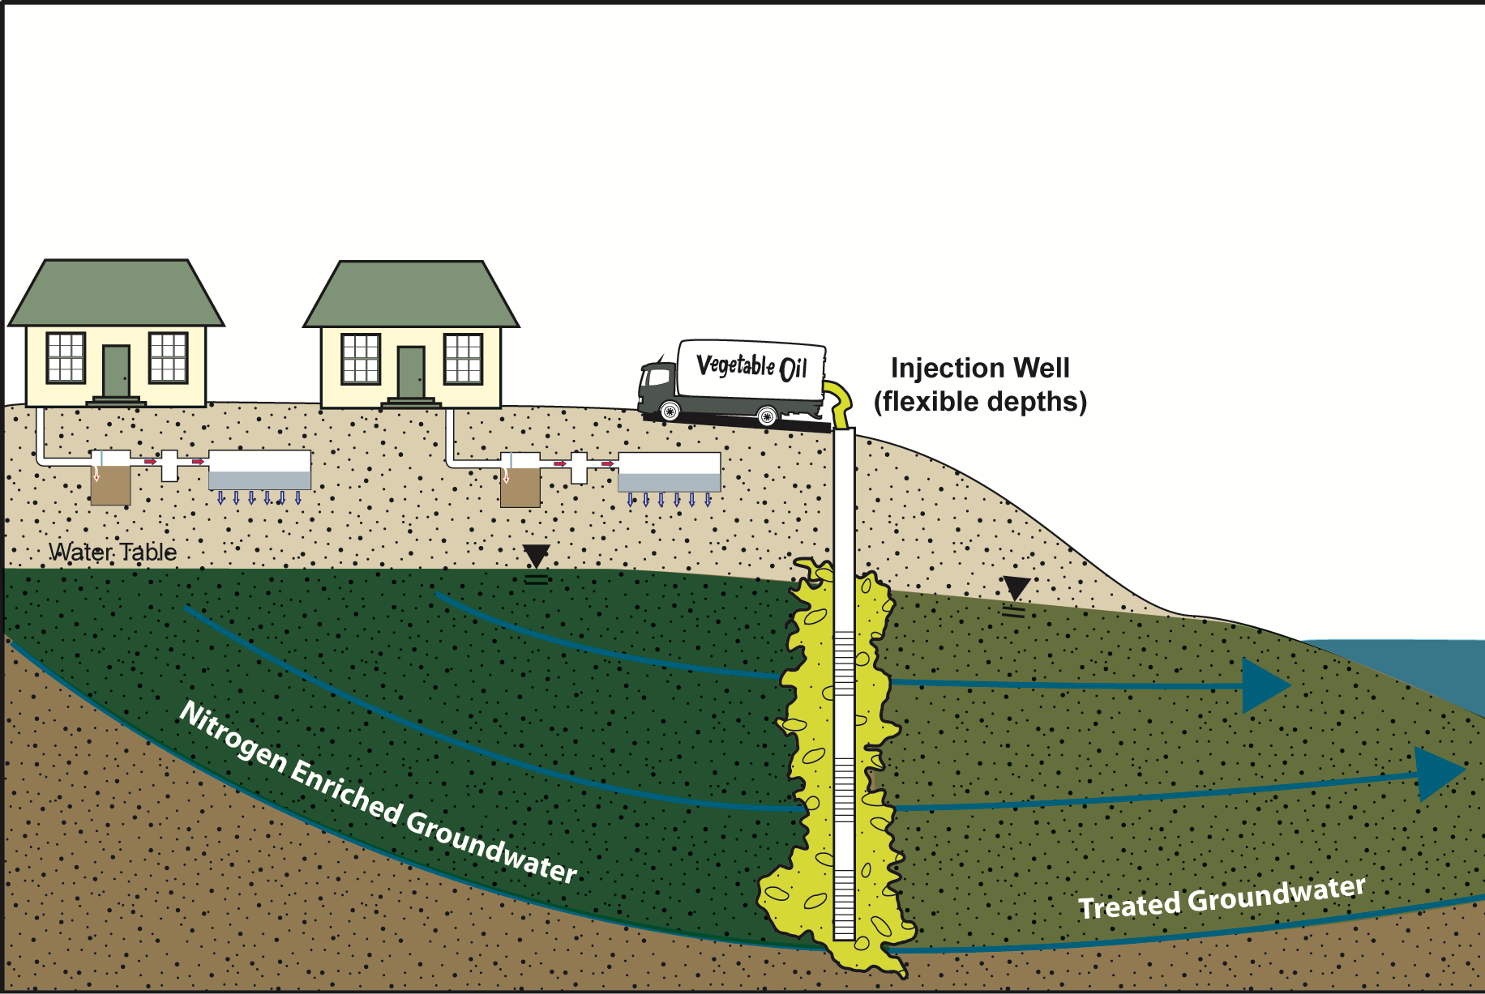
Trench and Injection Well PRBs

Slide 13
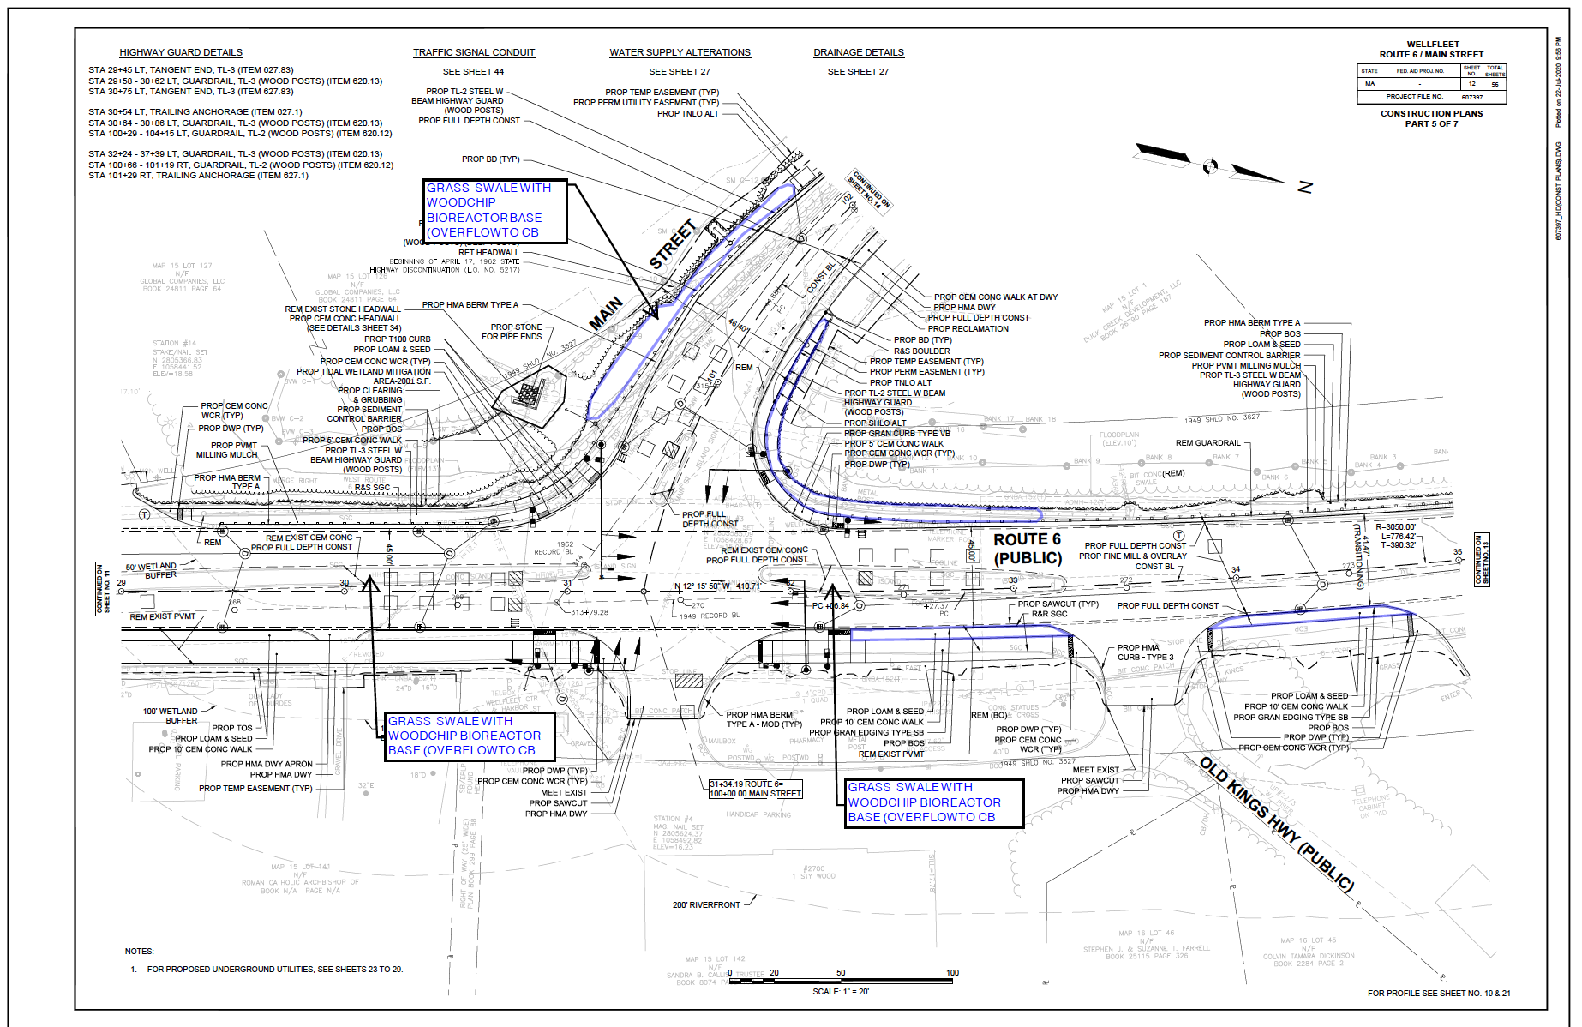
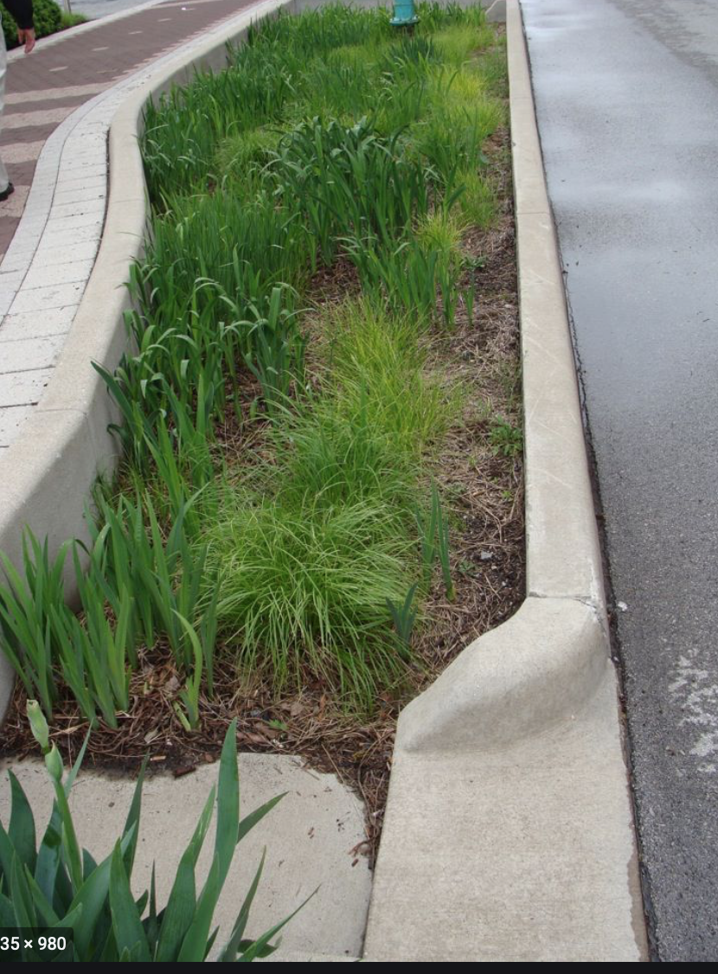
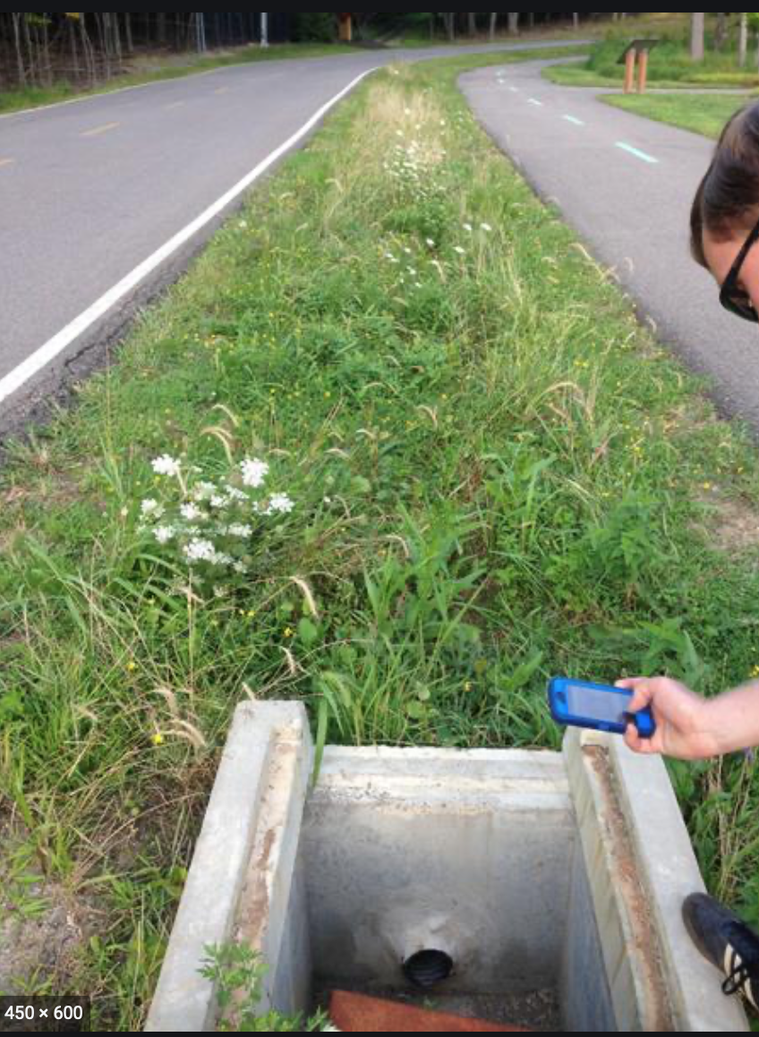

Slide 14
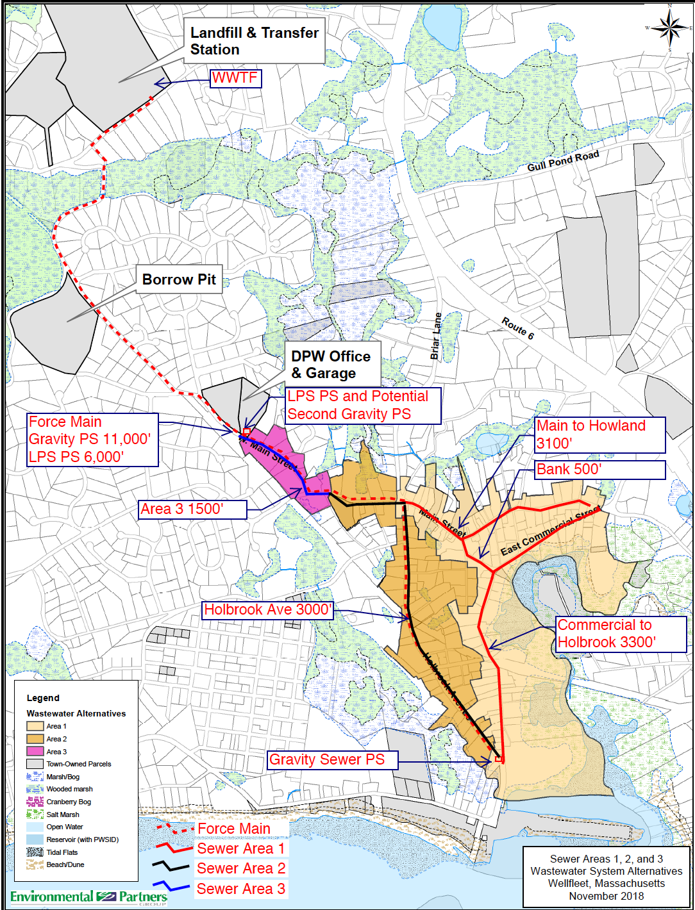
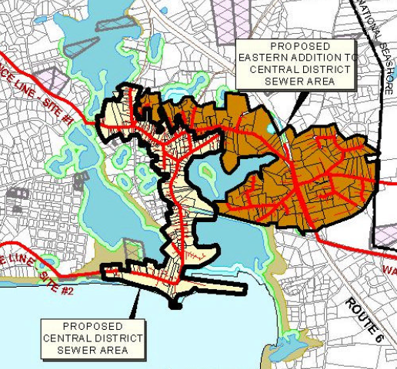
Woodard & Curran (2001)

Slide 15
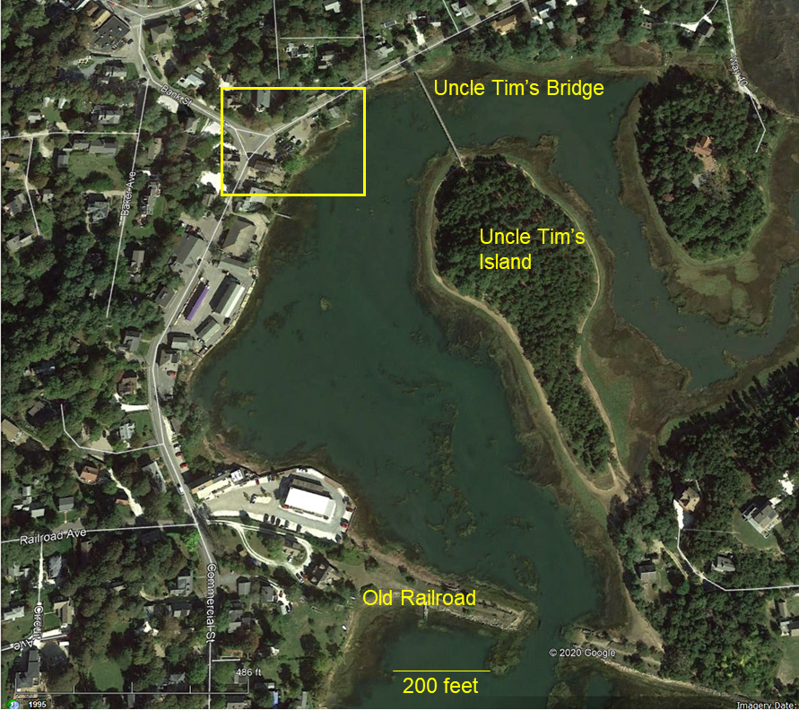
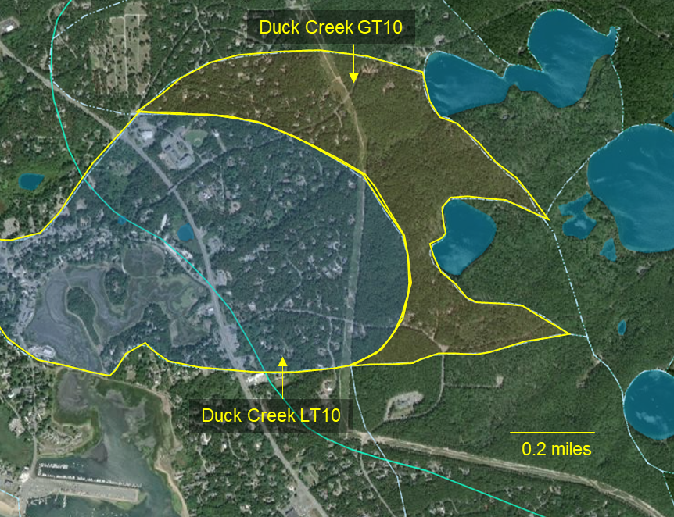
PRB Pilot
Duck Creek Watershed
Intersection Bank and Commercial Streets
Evaluate Injection, Trench & Bulkhead PRB Technologies
Short-Term WQ Benefits
Figure 3. Subwatersheds contributing to Duck Creek. The two subwatersheds are separated based on travel time to Duck Creek, either less than 10 years (LT10) or greater than 10 years (GT10). Source: Cape Cod Commission Regional Policy Plan Data Viewer (Cape Cod Commision, n.d.).

Slide 16
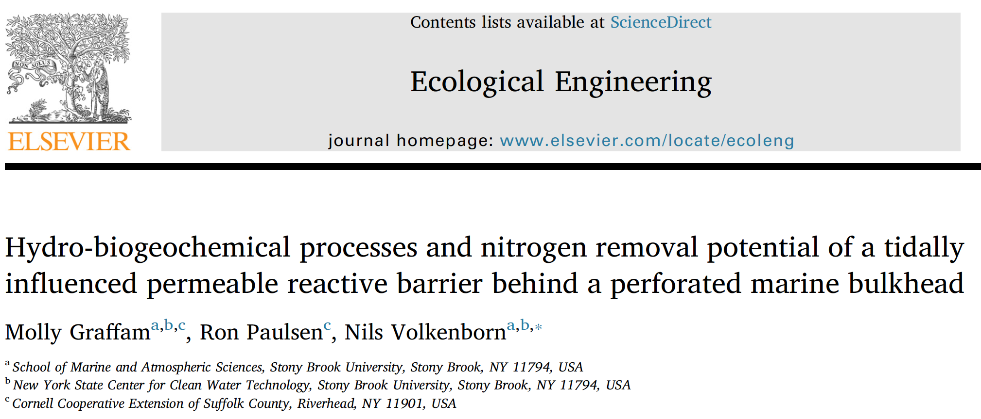

Slide 17
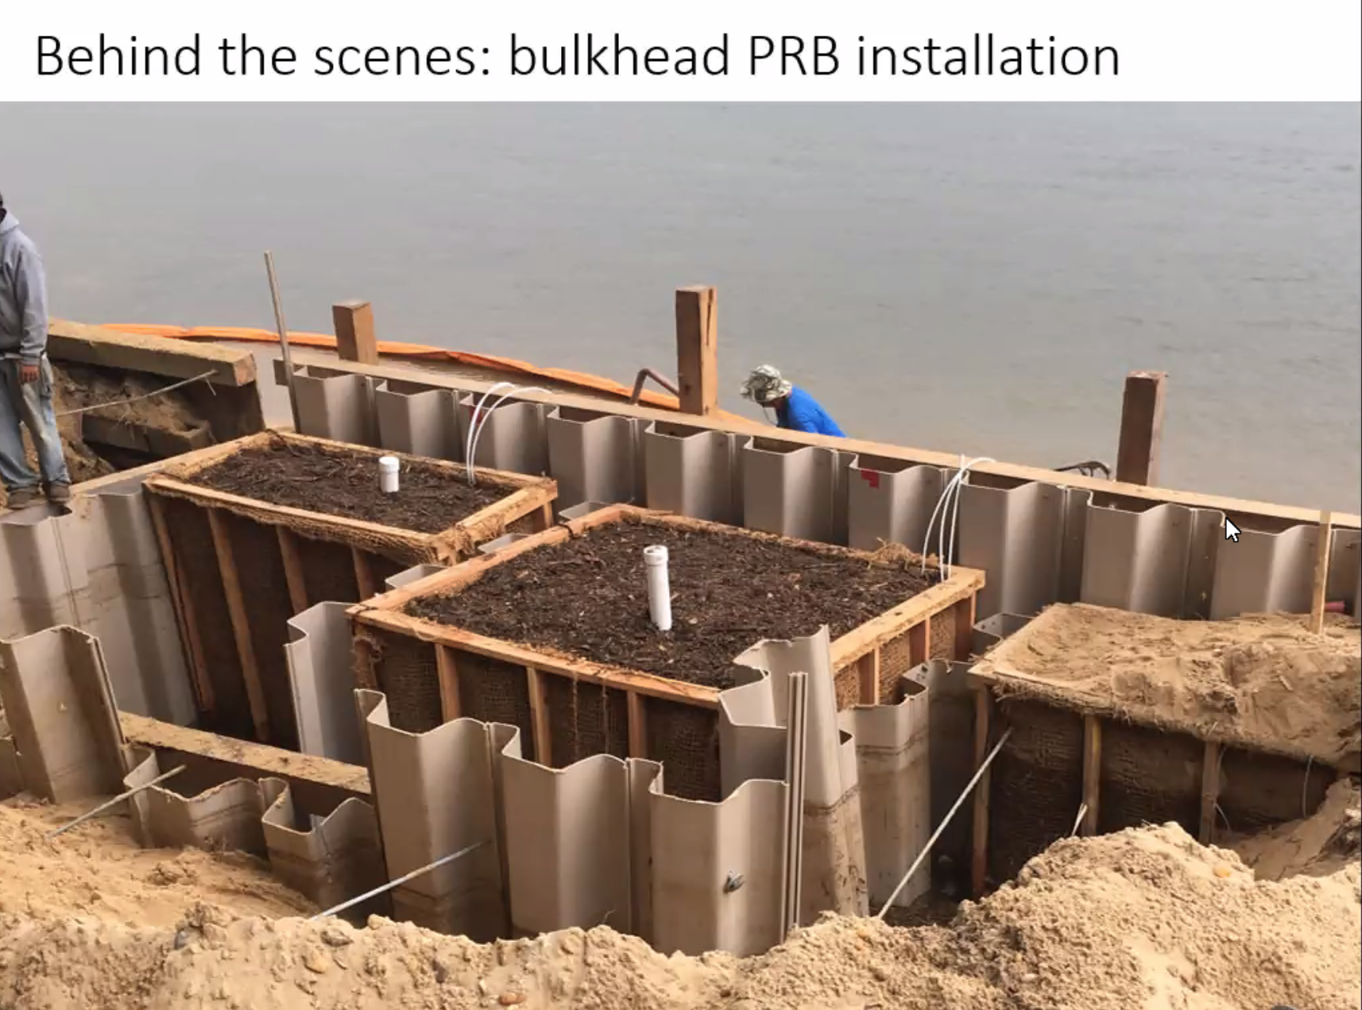
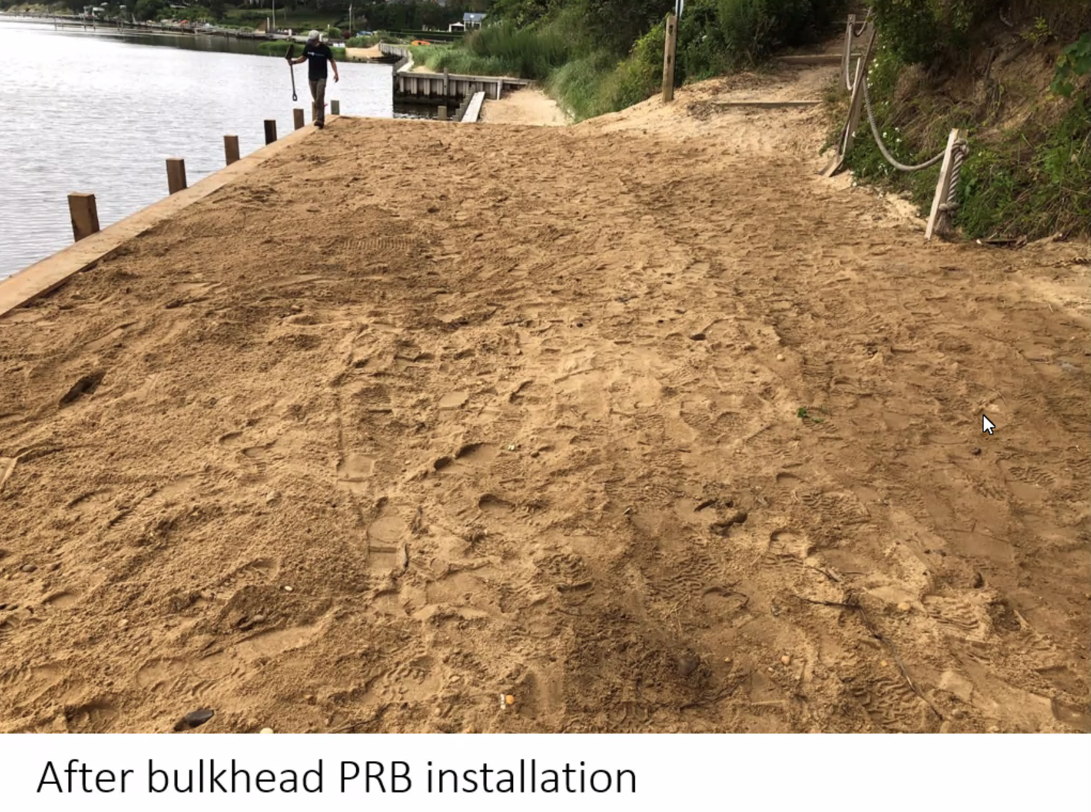

Slide 18
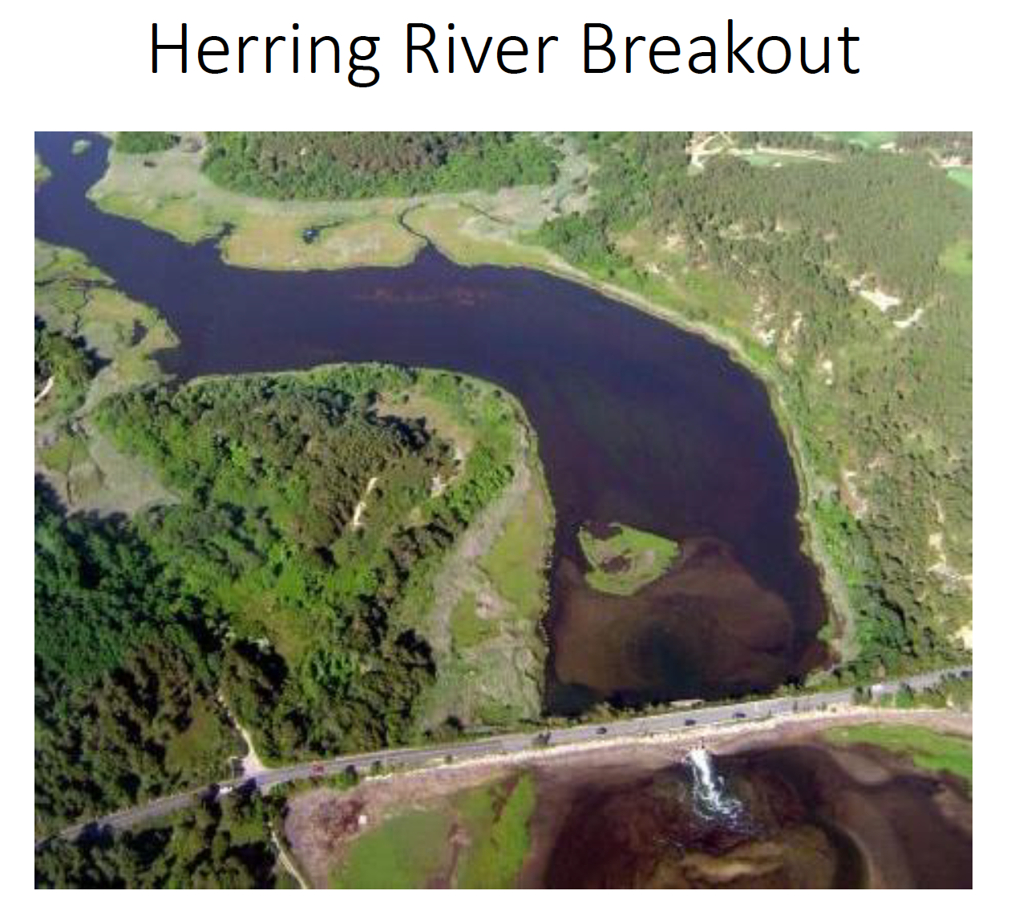
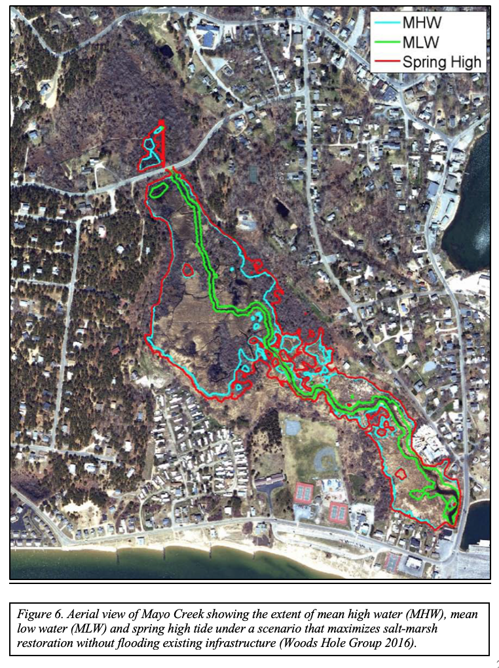
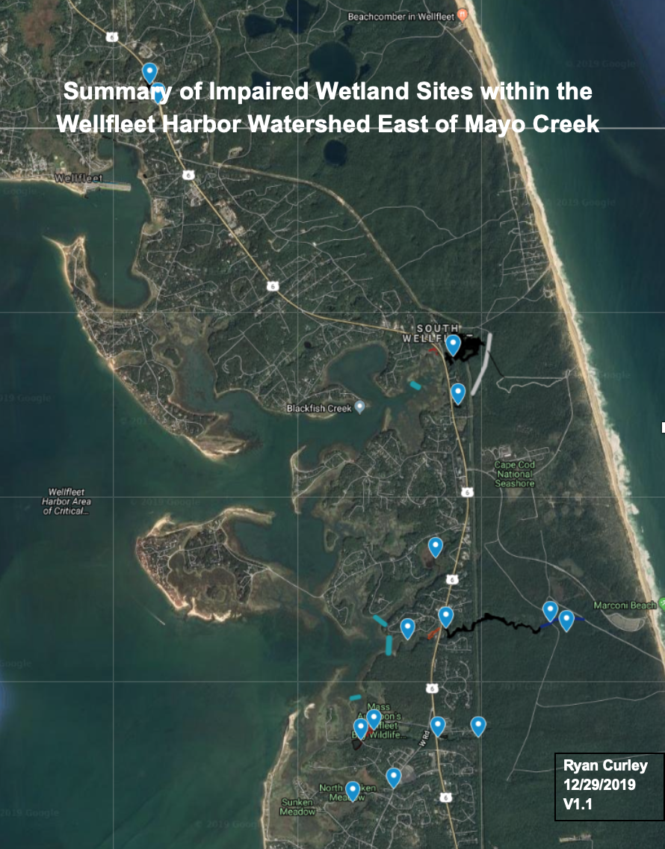
Coastal Ecosystem Restoration

Slide 19
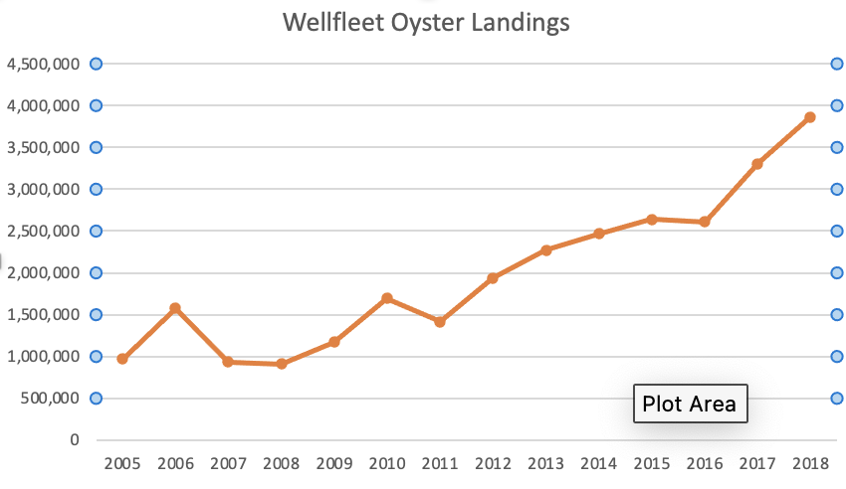
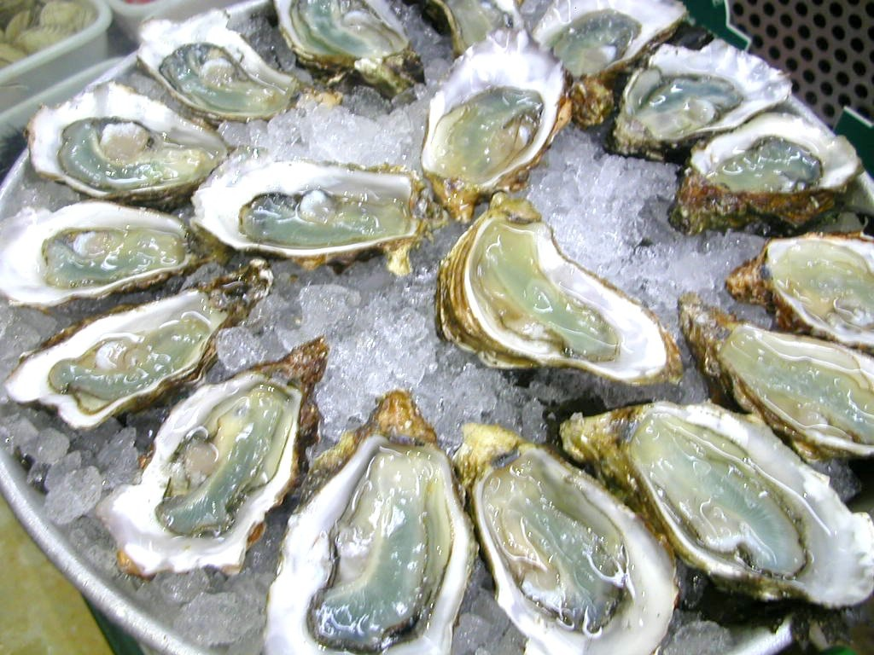

Slide 20
Wellfleet Septic System Upgrade Potential Using Enhanced I&A
 | Repairs | Upgrades & New Systems | Total | Potential N Reduction w Enhanced I&A (75%)
2017 | 18 | 48 | 66
2018 | 16 | 46 | 62
2019 | 17 | 52 | 69
Twenty-Year Estimate |  |  | 1313 | 4658 kg/year
Notes:
MEP assumptions include 145 gal/day-home and 23.63 mg/liter = 4.73 kg/year
MEP total watershed present watershed load = 79.74 kg/day
MEP target/threshold load = 54.85 kg/day
Reduction required = 24.89 kg/day (9085 kg/year)
Heufelder (2019) N effluent = 6 mg/liter (75% reduction)

Slide 21
Wellfleet Septic System Upgrade Potential Using Enhanced I&A
 | Real Estate Transfers |  | Total | Potential N Reduction w Enhanced I&A (75%)
2015 - 2019 | 483
Average Annual | 97
Twenty-Year Estimate |  |  | 1932 | 6854 kg/year
Notes:
MEP assumptions include 145 gal/day-home and 23.63 mg/liter = 4.73 kg/year
MEP total watershed present watershed load = 79.74 kg/day
MEP target/threshold load = 54.85 kg/day
Reduction required = 24.89 kg/day (9085 kg/year)
Heufelder (2019) N effluent = 6 mg/liter (75% reduction)

Slide 23
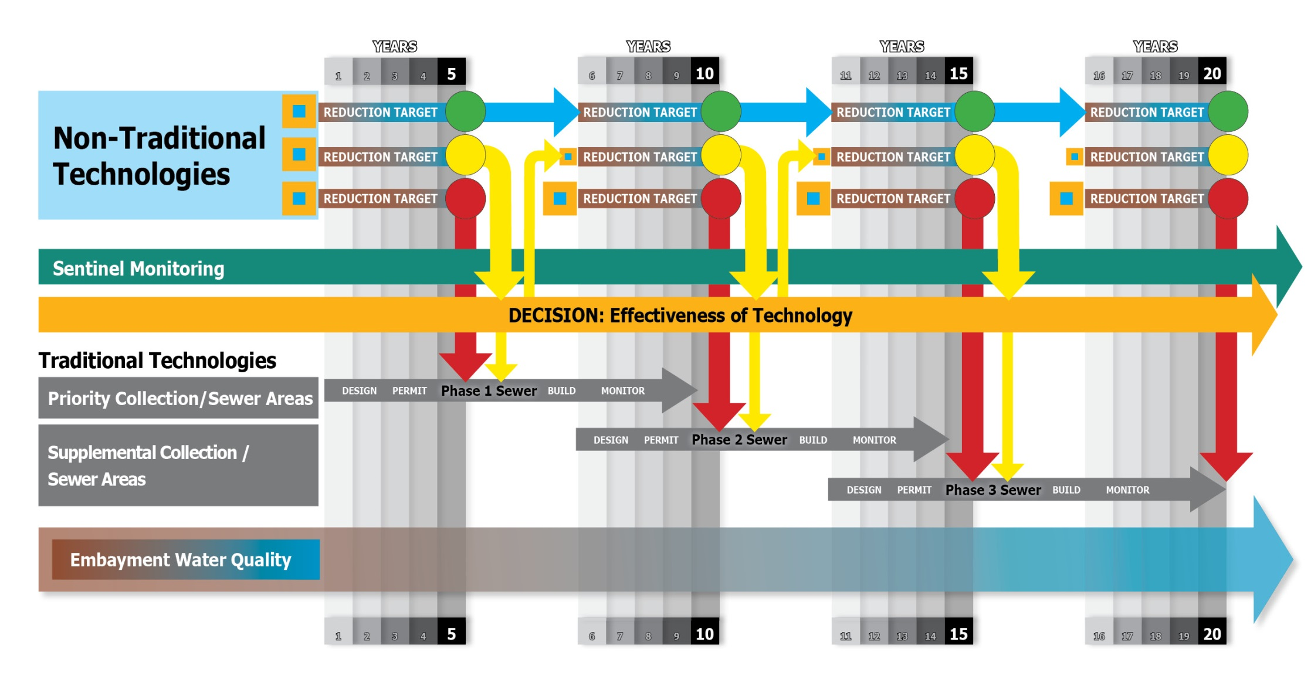
Watershed Permit Framework

