Slide 1
Land Transfer for Roadway Encroachment on NPS Land
Wed., July 1, 3-4:30 pm
Via Webex

Slide 2
Herring River Restoration Project
Land Transfers for Road Encroachment
  Elevation and increased slope of low road segments encroaches on NPS land
    Encroachment from town roads elevation extends ≈2 non-contiguous miles ≈ 2ac of encroachment
    Add’l encroachment from High Toss Rd elevation - TBD
    Road design minimizes encroachment on private land; maintains ≈ 3:1 slope for wildlife

Slide 3
Herring River Restoration Project
Land Transfers for Road Encroachment
  Roads involved:
  Old County
  Bound Brook Island Road (Including private driveway)
  Pole Dike Road
  High Toss Road
  NPS unable to grant ROW permit for transportation– Process requires land swap whereby Town identifies parcels to provide to NPS in exchange for fee interest in areas of encroachment on NPS land.

Slide 4
Herring River Restoration Project
Land Transfers for Road Encroachment
  Key steps (apply to Town and NPS parcels) – this is a See attachment for more process detail
    Finalize encroachment areas & identify town parcels
    Legal description of parcels with metes & bounds
    Appraisal of parcels
    Execute/transfer
  Town – NPS work group to discuss details, identify resources and actions needed

Slide 5
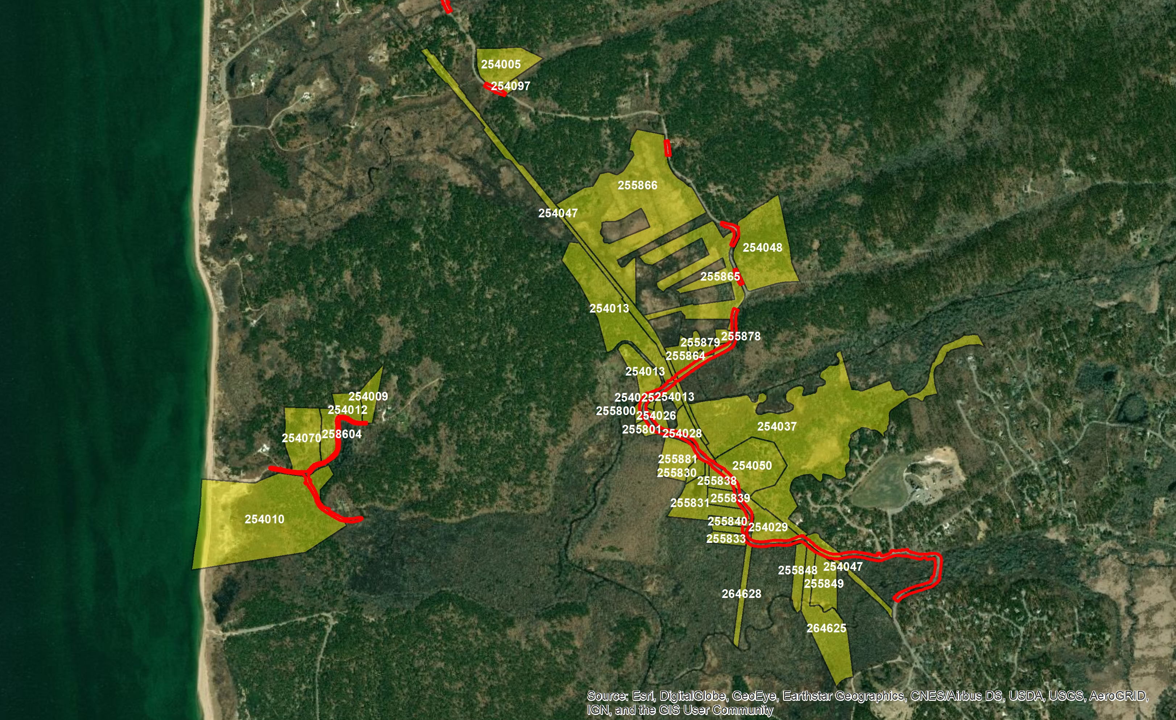
Old County, Bound Brook Island and Pole Dike Roads

Slide 8
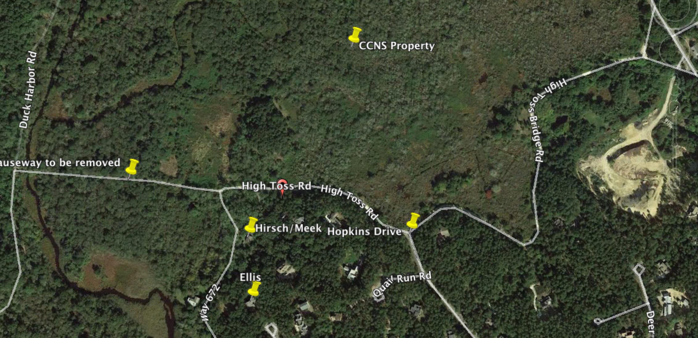
High Toss Road

