Slide 1
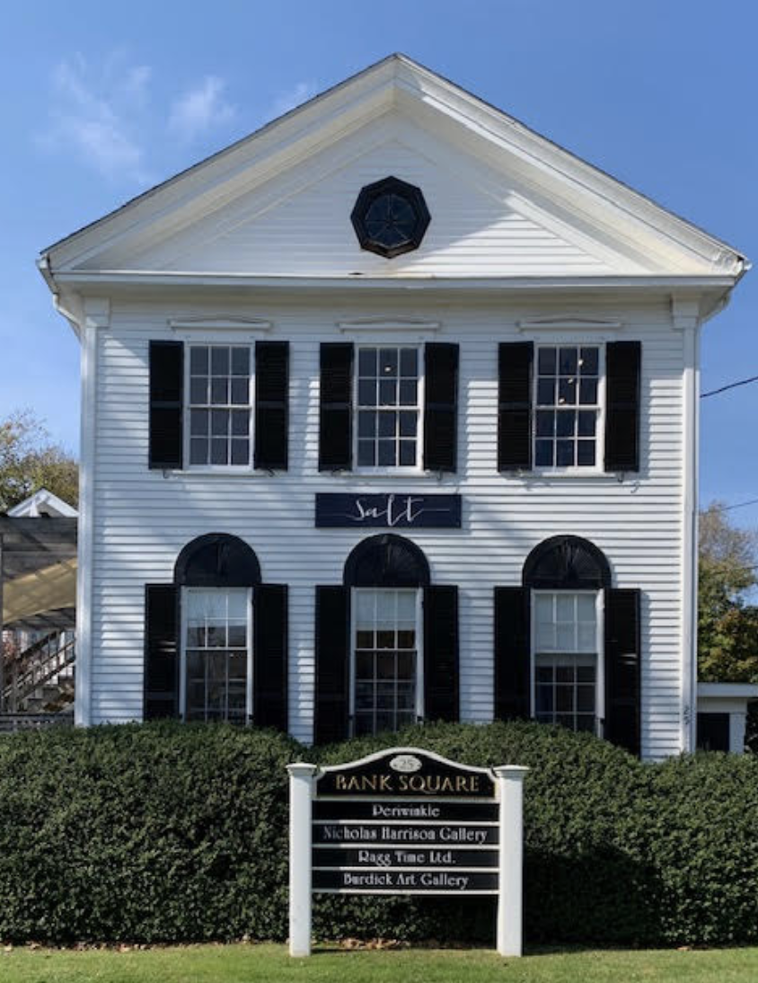
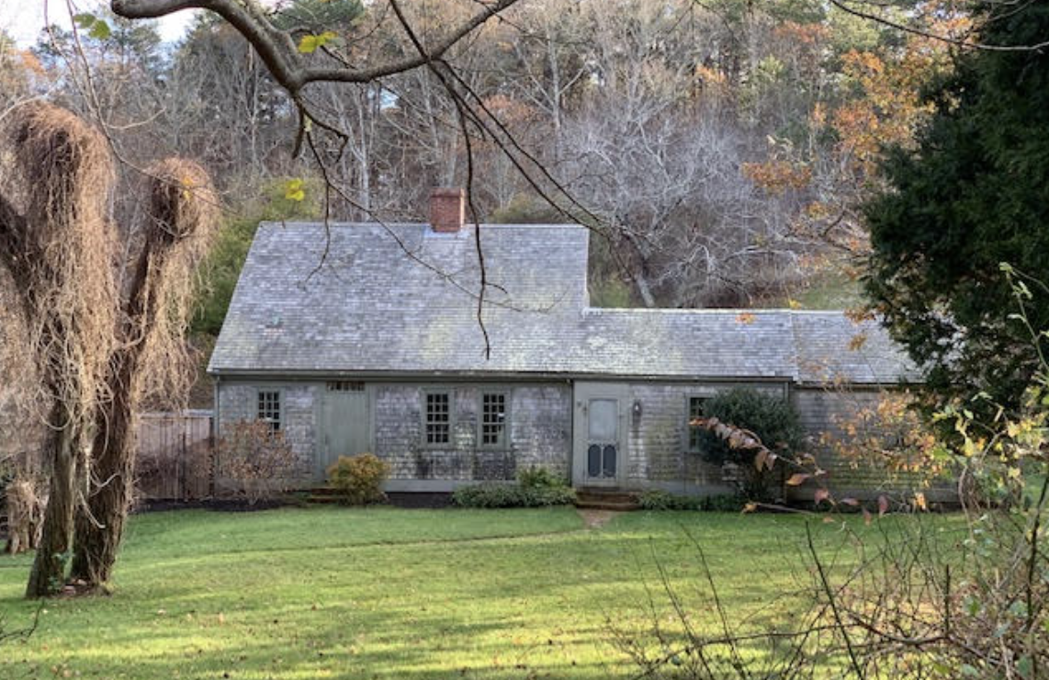
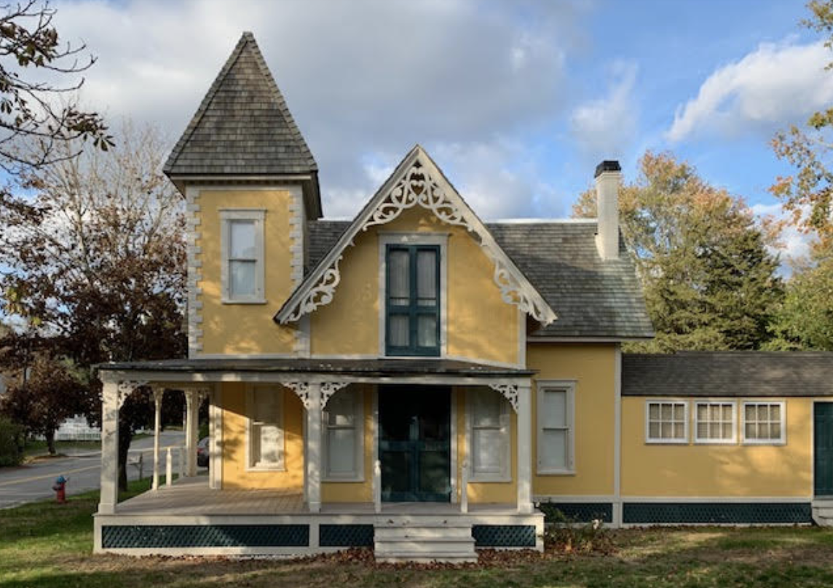
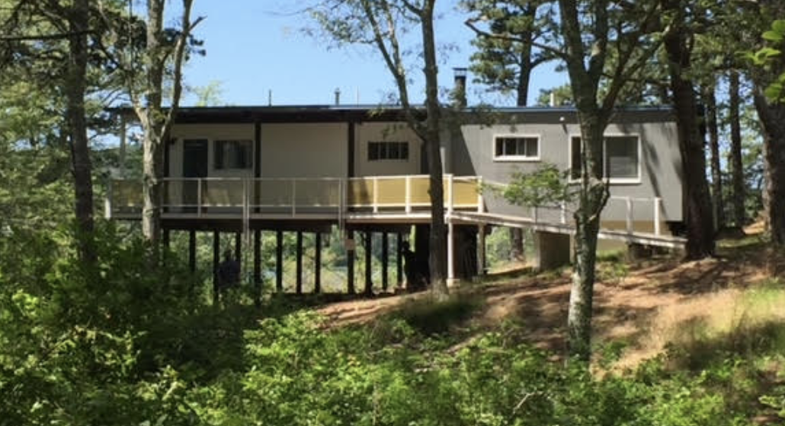
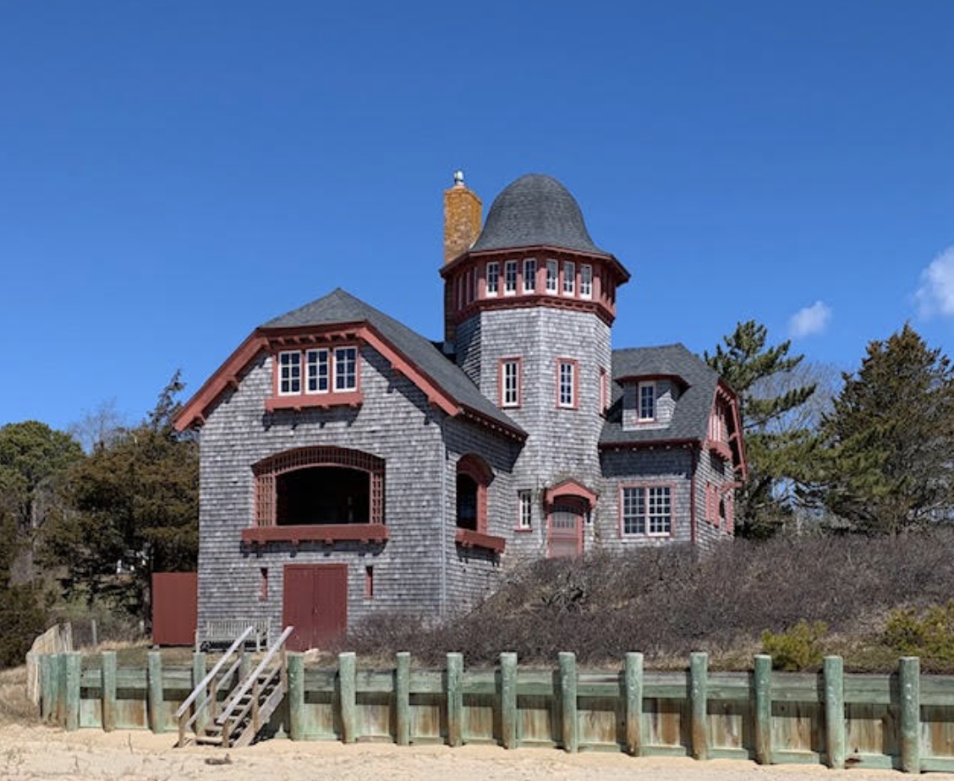
Amending wellfleet’s Demolition Delay By-law
Merrill Mead-Fox
Wellfleet Historical Commission
wellfleethistoricalcommission@gmail.com

Slide 2
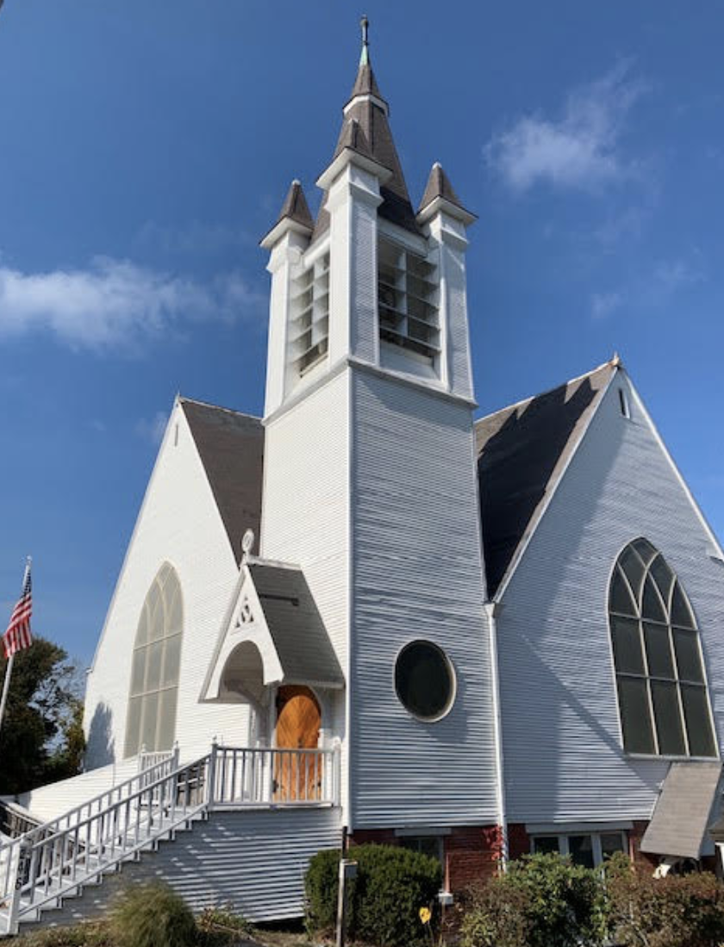
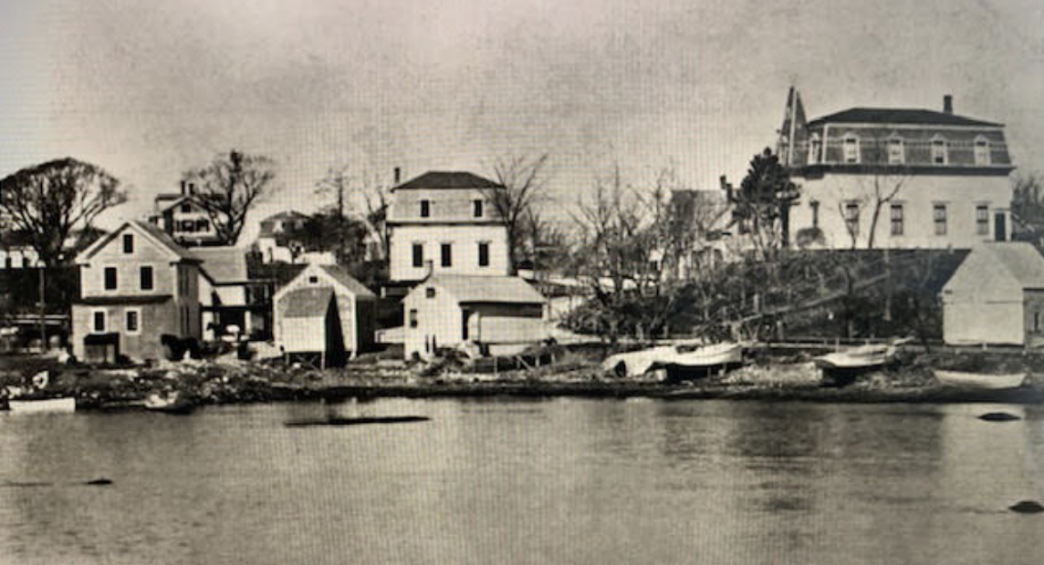
Background: The Wellfleet Historical Commission (WHC)
Established by Town Meeting vote in 1986 to preserve and protect historic structures and archeological assets in the town of Wellfleet
Reviews projects that involve partial or full demolition of architecturally and historically significant structures
Hires Preservation Specialists to update Historic Inventories and the Wellfleet Survey Street Index

Slide 3
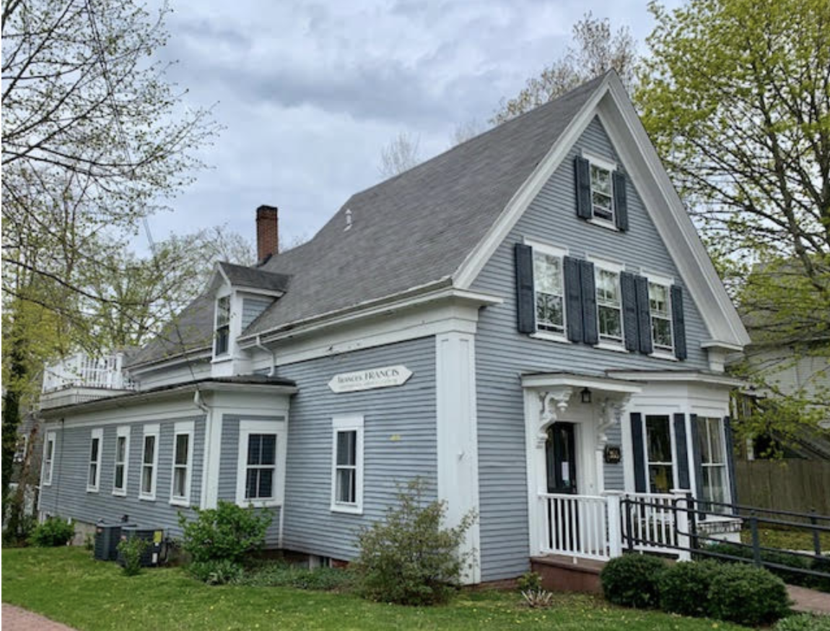
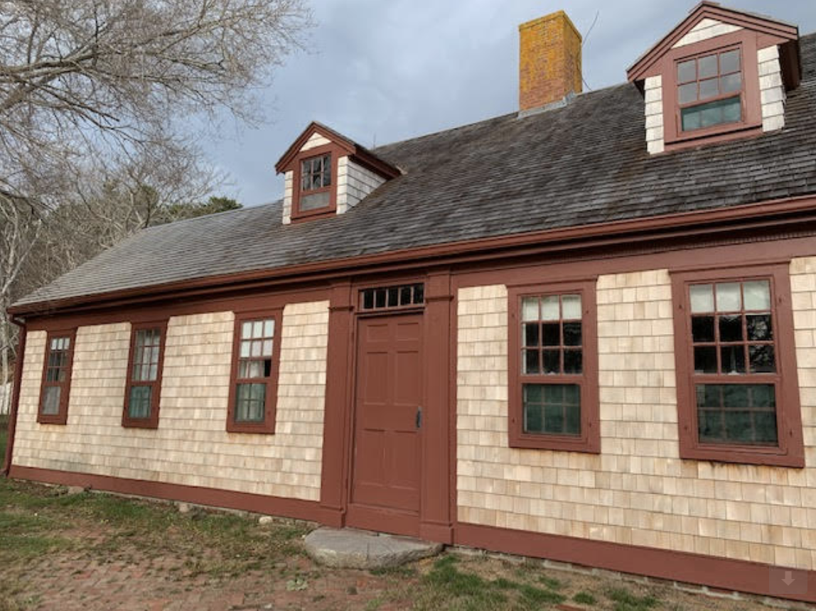
Background: Why Preservation Matters
Historic buildings:
are a nonrenewable resource
attract people who shop, rent and buy houses in Wellfleet
have been successfully renovated for new uses throughout the Cape
Preservation:
reduces construction waste
is more sustainable than using non-biodegradable manufactured products
enhances the real estate values of all houses in Wellfleet

Slide 4
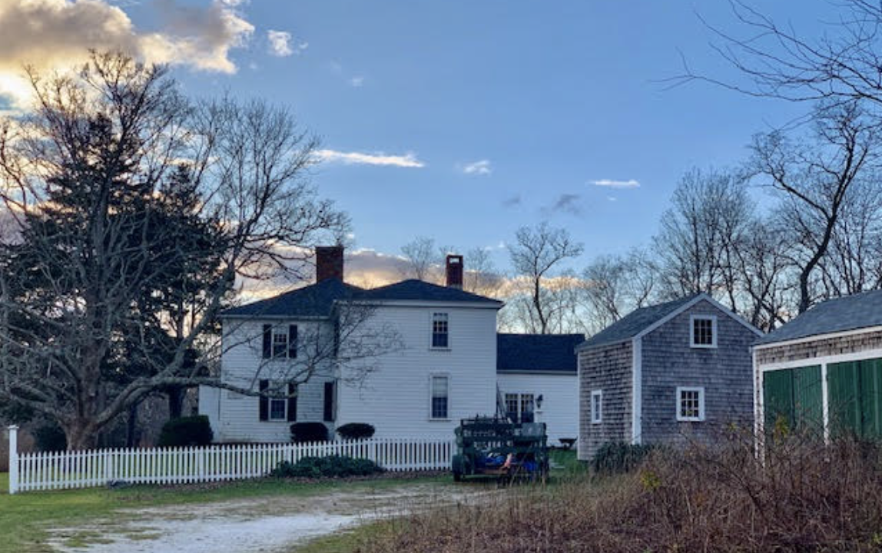
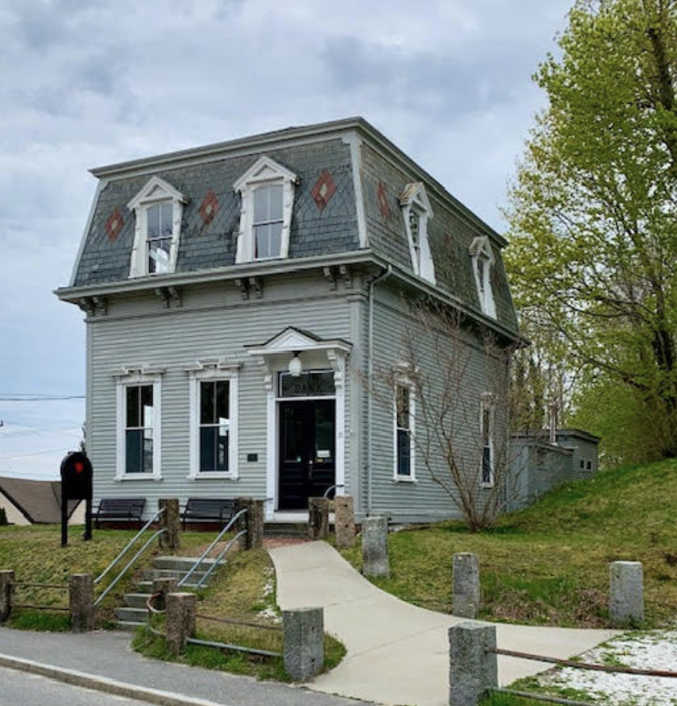
Background: Preservation in Wellfleet is currently by two statutes
The Cape Cod Commission Act:
Demolition and substantial alteration of NRHP and NRHD properties require CCC review
Wellfleet’s Demolition Delay By-law (DDB):
Enables the Historical Commission to declare a Demolition Delay of up to 18 months
The length of the delay is shortened if the owner and the Commission find a compromise
If no compromise is reached, the owner is allowed to demolish the building
NRHP: National Register of Historic Places NRHD: National Register Historic District

Slide 5
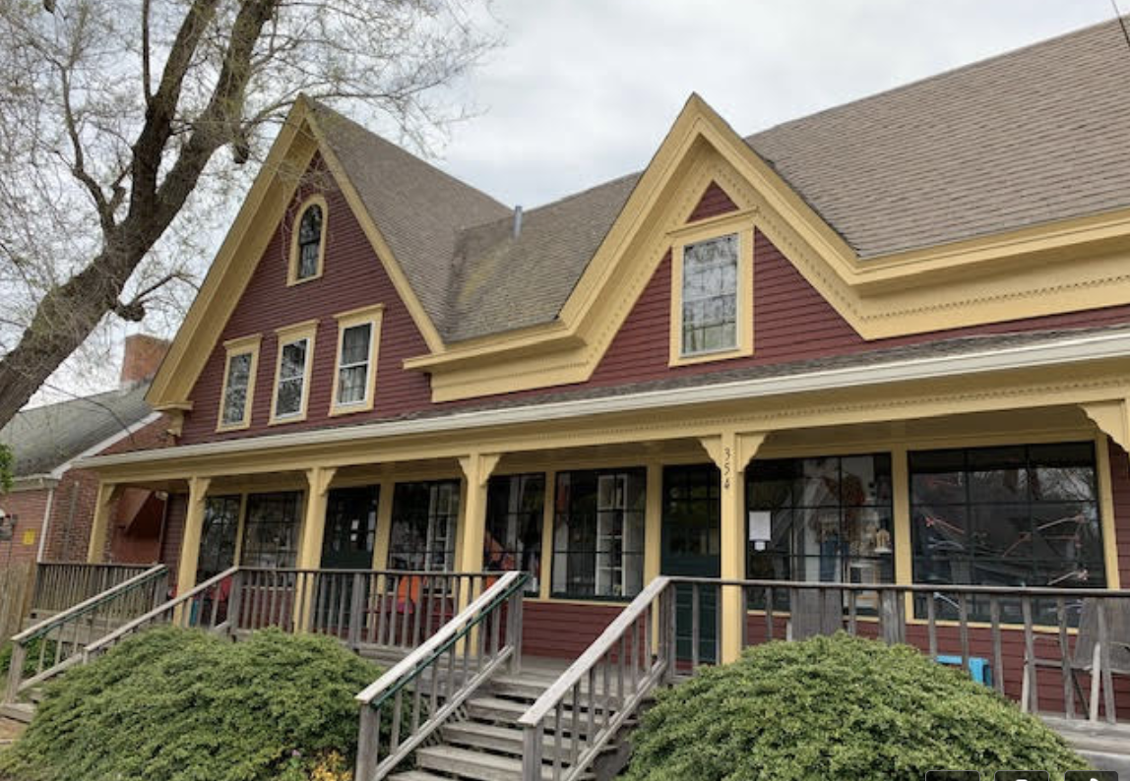
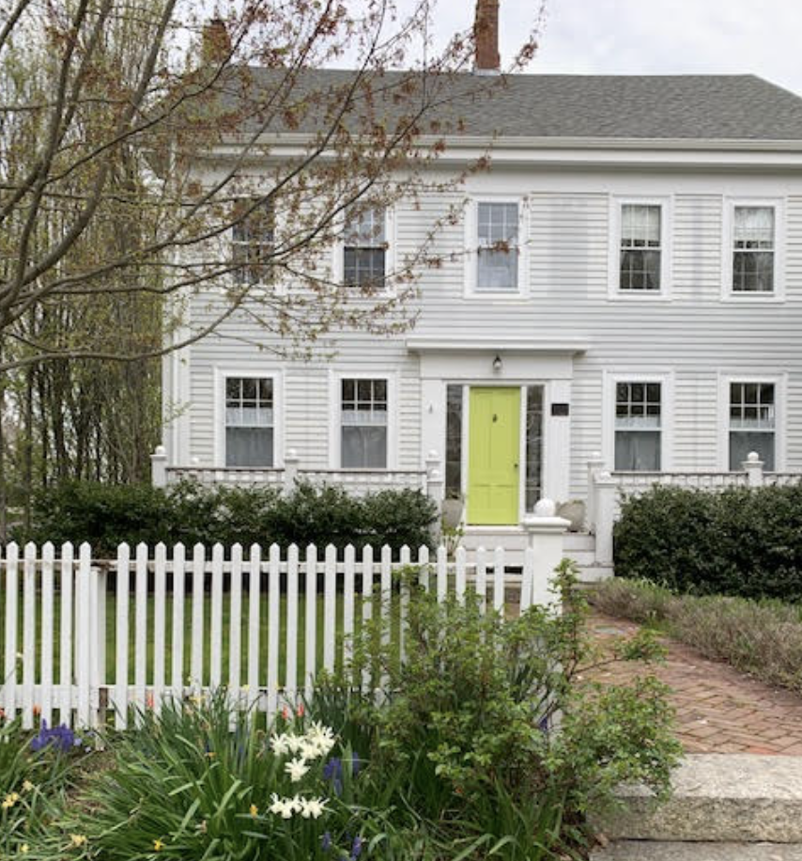
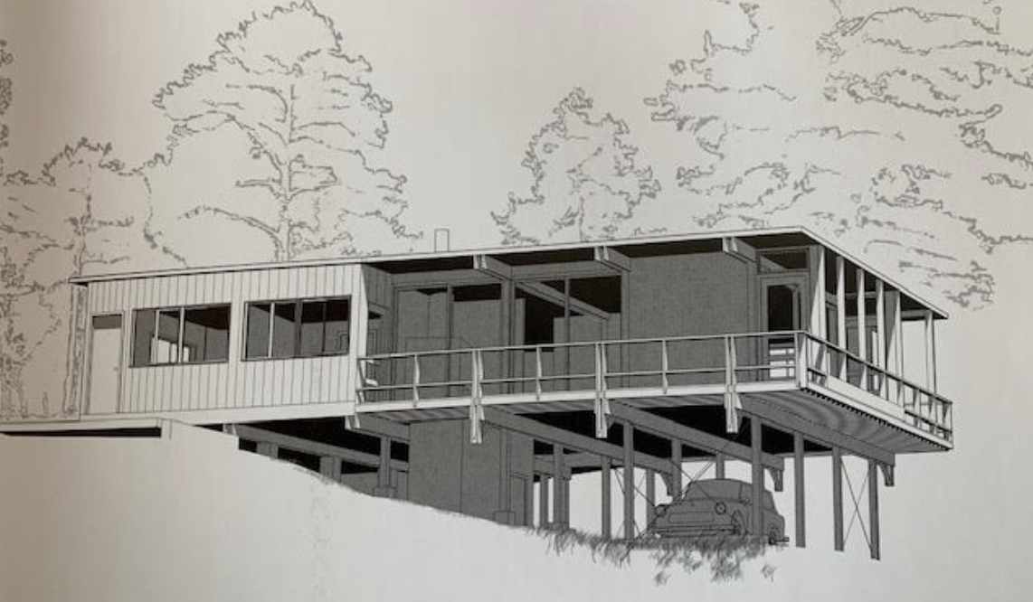
Background: Limits to WHC Purview
The WHC has the power to delay, but not prevent, demolition of historic buildings
The WHC has no jurisdiction over the interior of buildings
Normal maintenance and repair such as exterior painting, roofing, and window replacement (to the extent there is no demolition) are not within our jurisdiction

Slide 6
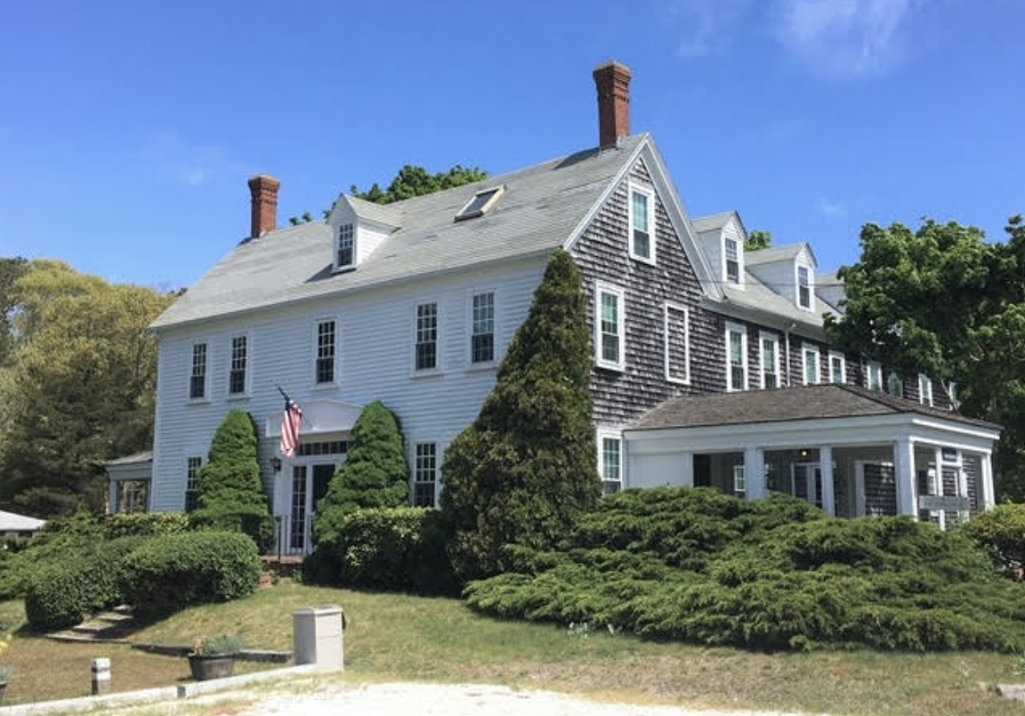
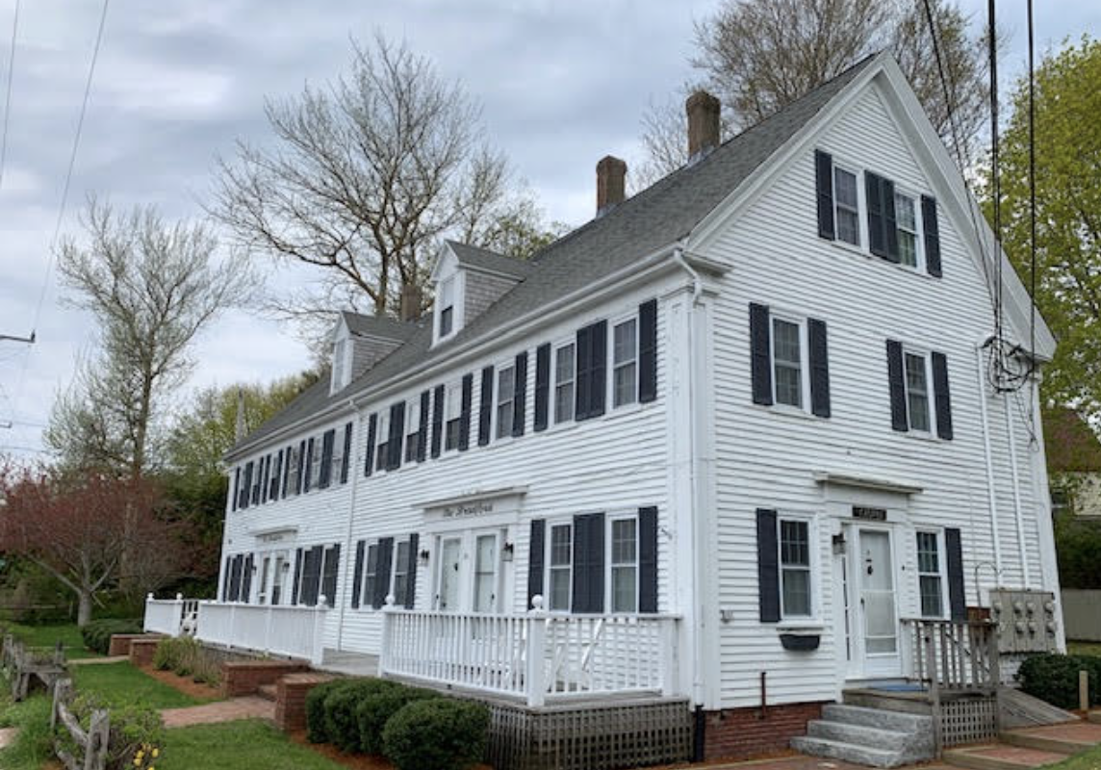
Why amend the DEMOLITION DELAY BY-LAW
Wellfleet’s current DDB was adopted in 1996
WHC is seeking to
clarify the threshold for referral
clarify the Review and Decision Procedure
ensure the WHC can require an independent evaluation of structural integrity
Many Massachusetts towns have updated their DDBs, making use of the MHC Sample By-law
Truro updated their DDB in 2017, making changes similar to those we are proposing
MHC: Massachusetts Historical Commission

Slide 7
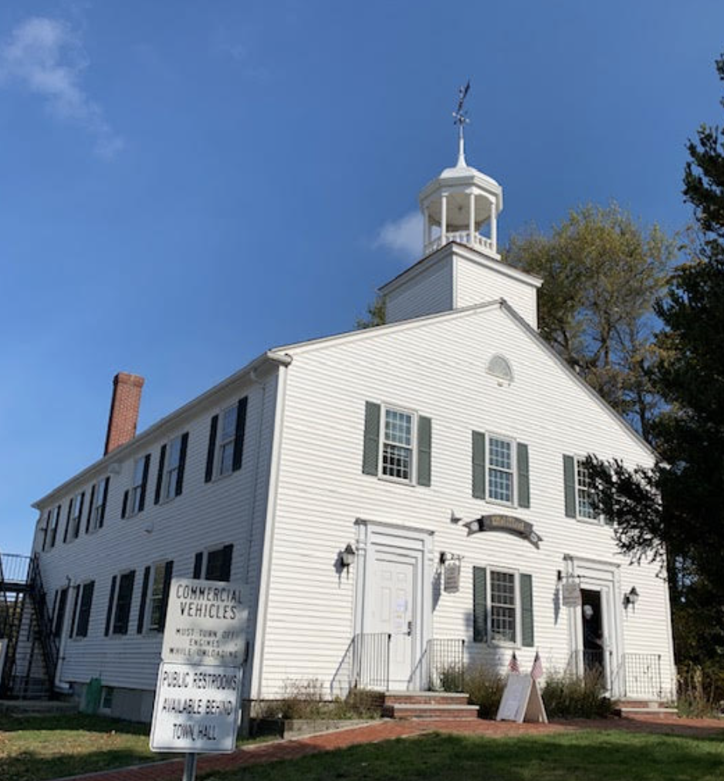
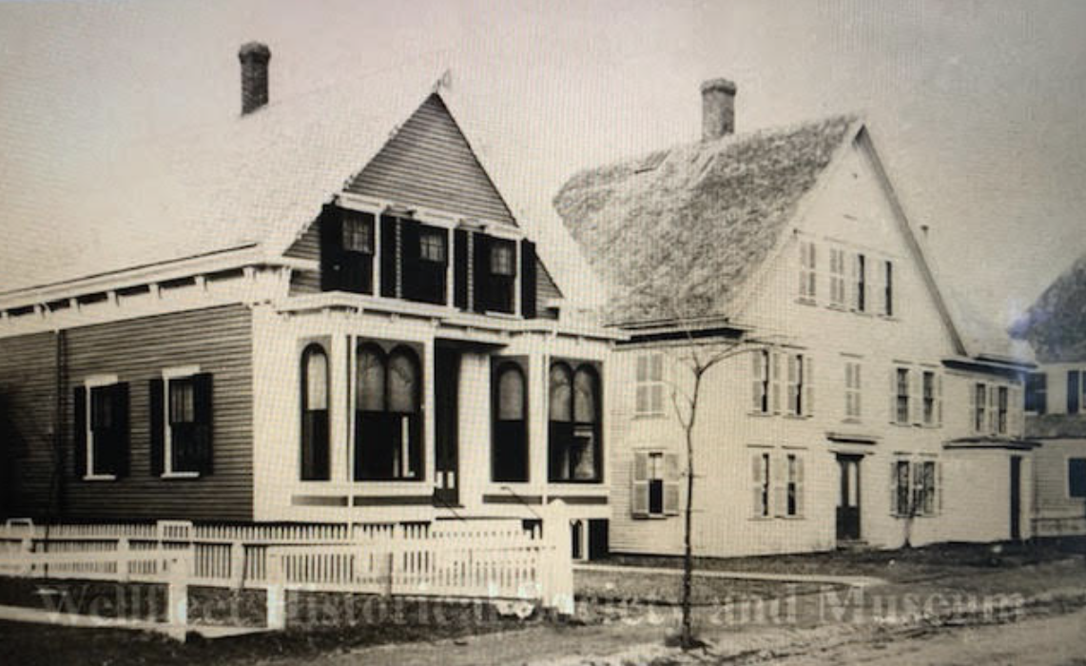
THE WHC HAS BEEN WORKING TO AMEND THIS BY-LAW SINCE September 2022
Consulted with the MHC and the CCC
Communicated with Wellfleet’s Building Commissioner, Assistant Town Administrator, Town Clerk, and Selectboard Members
Researched the MHC Sample By-law and DDBs of several other Massachusetts towns
Held several Open Meetings by Zoom in order to agree on our proposed amendments
Met with the Selectboard twice about these amendments
Town Counsel has reviewed and edited these amendments

Slide 8
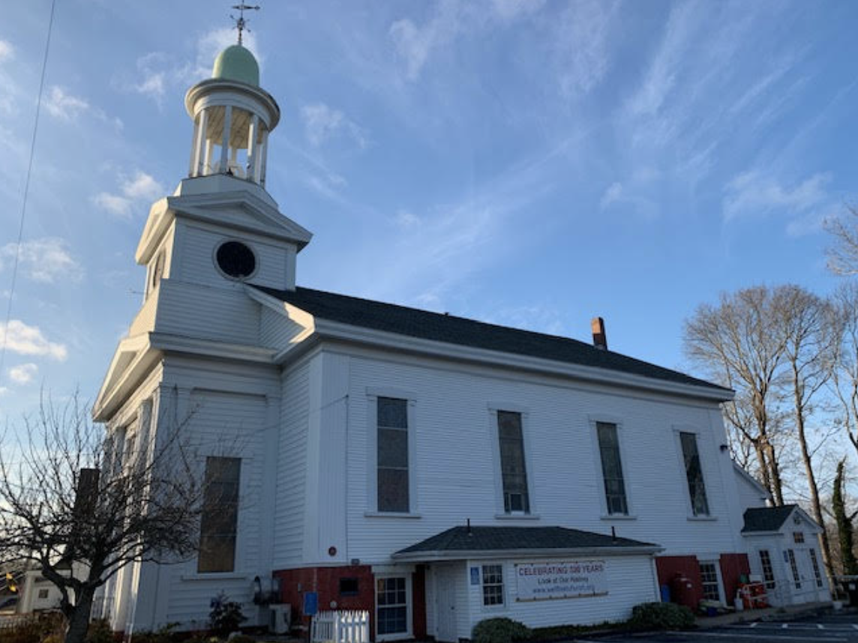
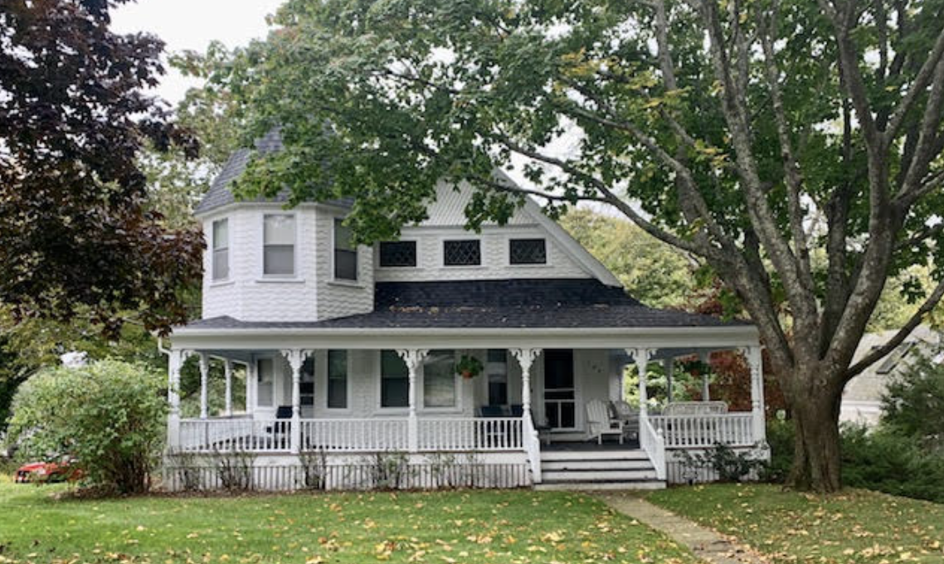
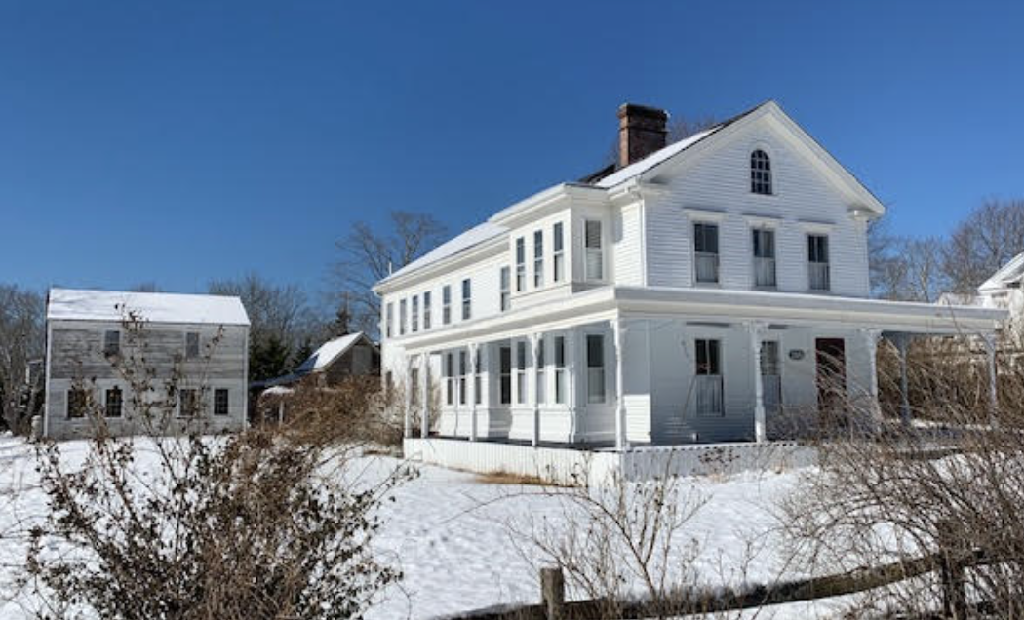
FIRST: Clarify the threshold for referral
Current By-Law:
Building Department primarily refers buildings over 75 years old
Amended By-Law:
Building Commissioner refers buildings on Wellfleet Survey Street Index
This ensures that significant buildings which reflect the historical, cultural, and architectural heritage of the town will be included

Slide 9
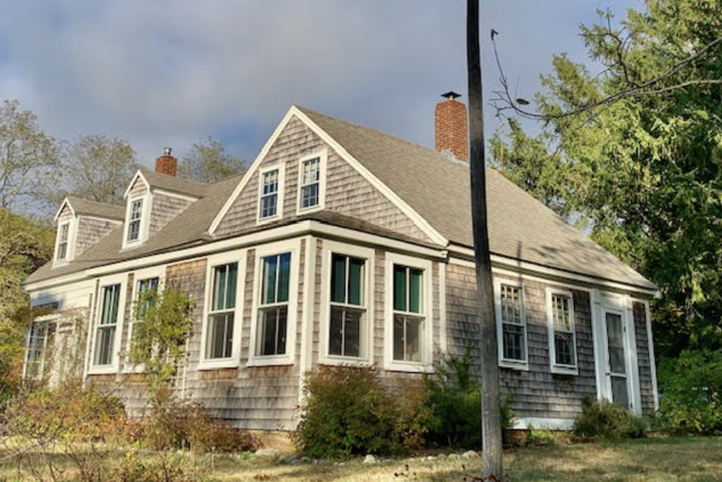
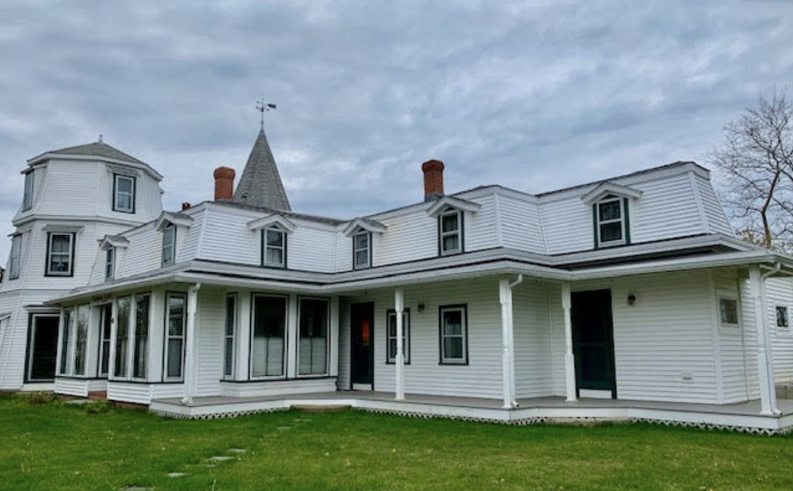
second: CLARIFY THE REVIEW AND DECISION PROCEDURE
Current By-law:
Building Department decides which buildings to refer to WHC
Commission decides whether the building is preferably preserved
Public Hearing is held to explore alternatives to demolition
Amended By-law:
Building Department refers all buildings on Wellfleet Survey Street Index to WHC
Commission determines whether the building is significant
Hearing is held to determine whether the building is preferably preserved
Alternatives to demolition are explored in the hearing & during the Demolition Delay period

Slide 10
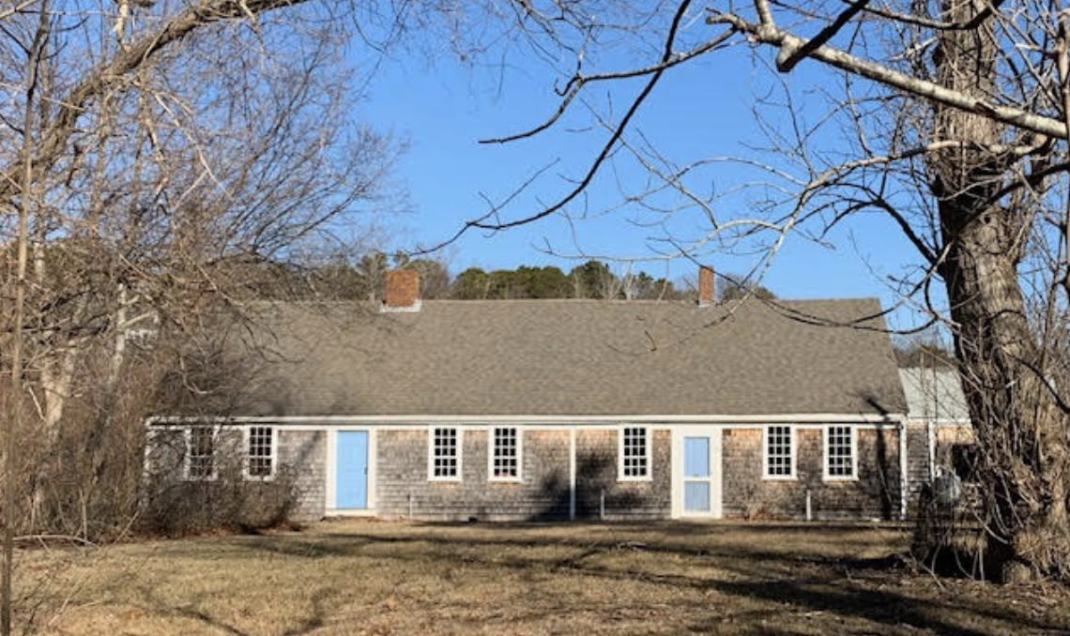
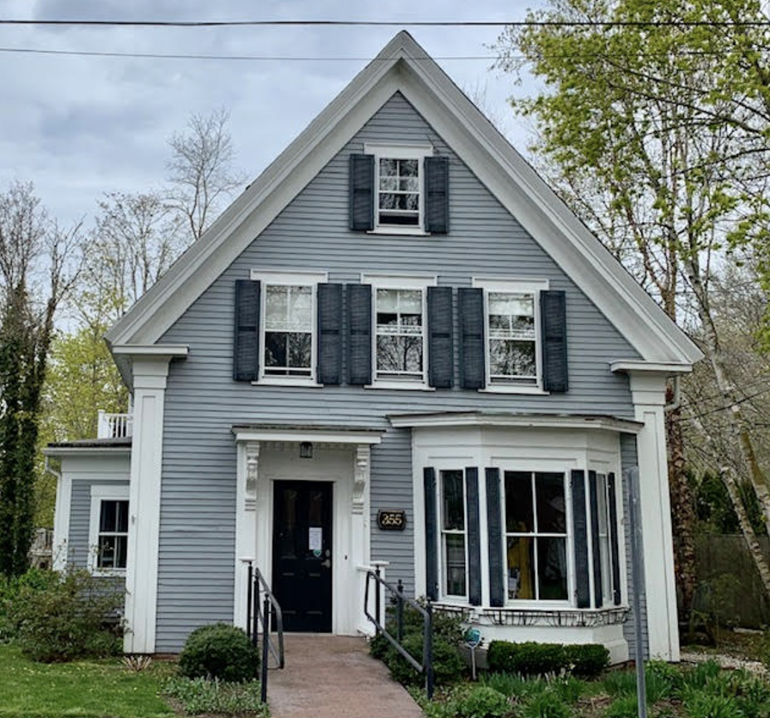
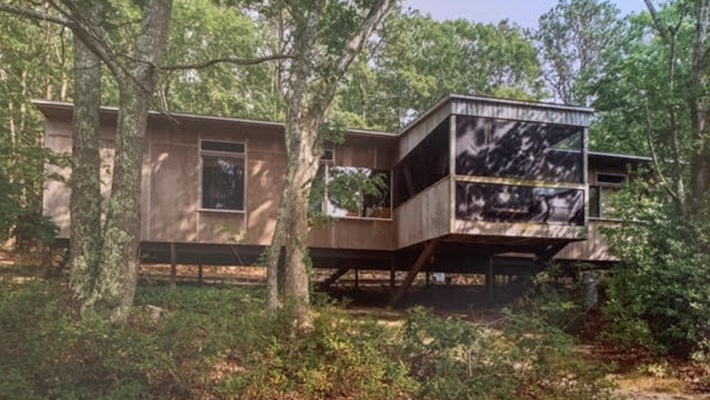
third: EVALUATE CLAIMS THAT A BUILDING IS STRUCTURALLY UNSOUND
Current By-law:
Does not provide any option for requiring an independent evaluation of structural integrity
Amended By-law:
New section enables the Commission to require that a Structural Engineer be hired to evaluate the structural integrity of a building

Slide 11
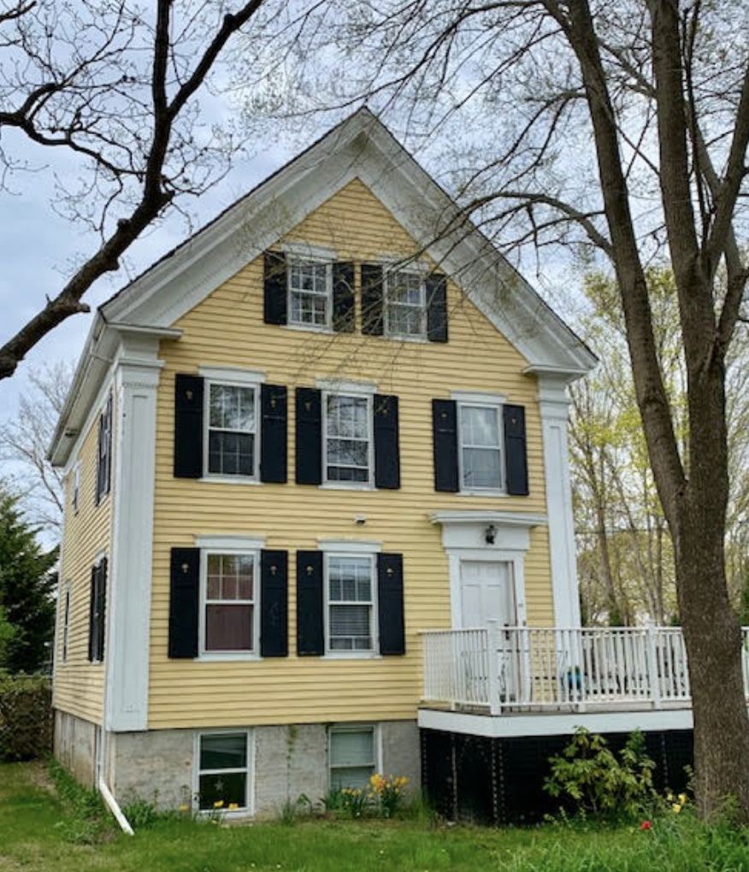
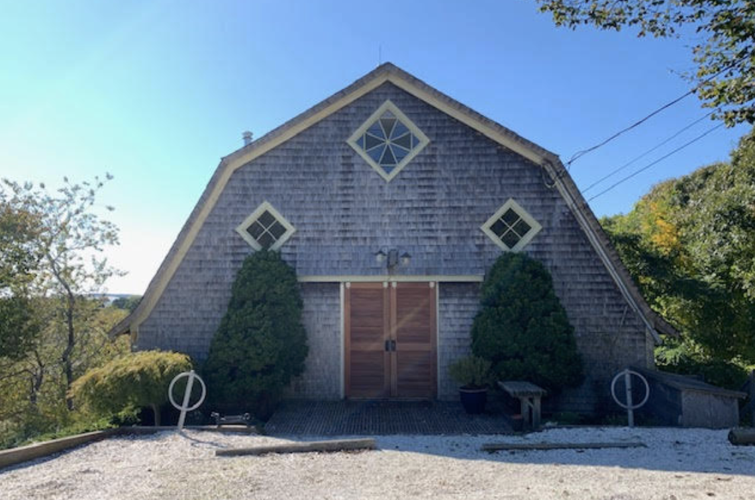
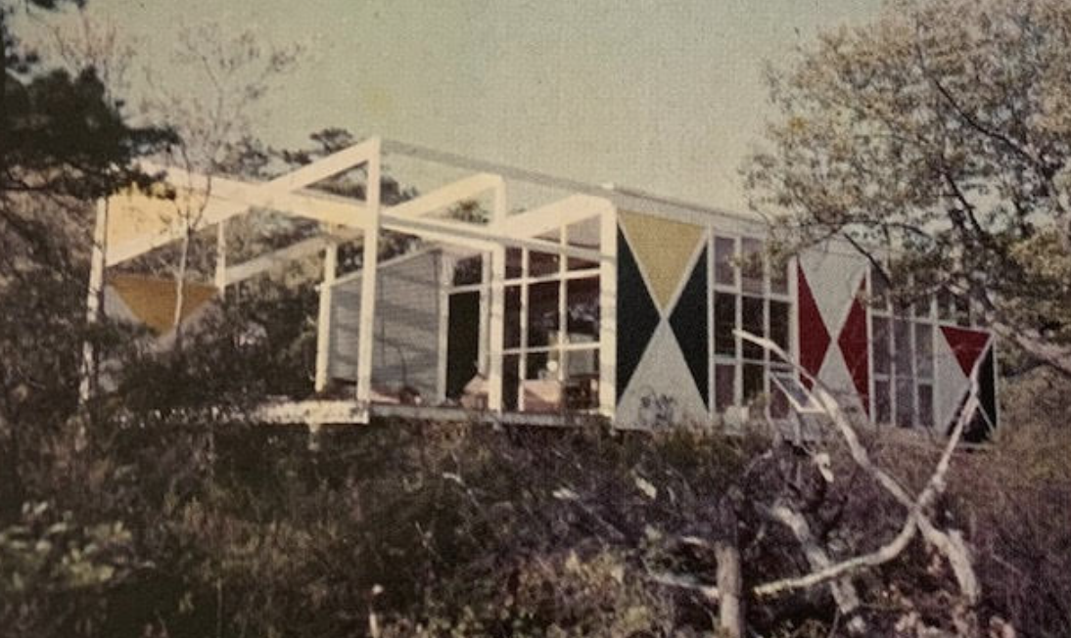
summary
These By-Law amendments:
will clarify definitions and procedures to help the WHC and building Department work together more efficiently and effectively
reflect best practices based on MHC Sample By-Law
enhance our ability to preserve and protect historic structures and archeological assets in the town of Wellfleet

Slide 12
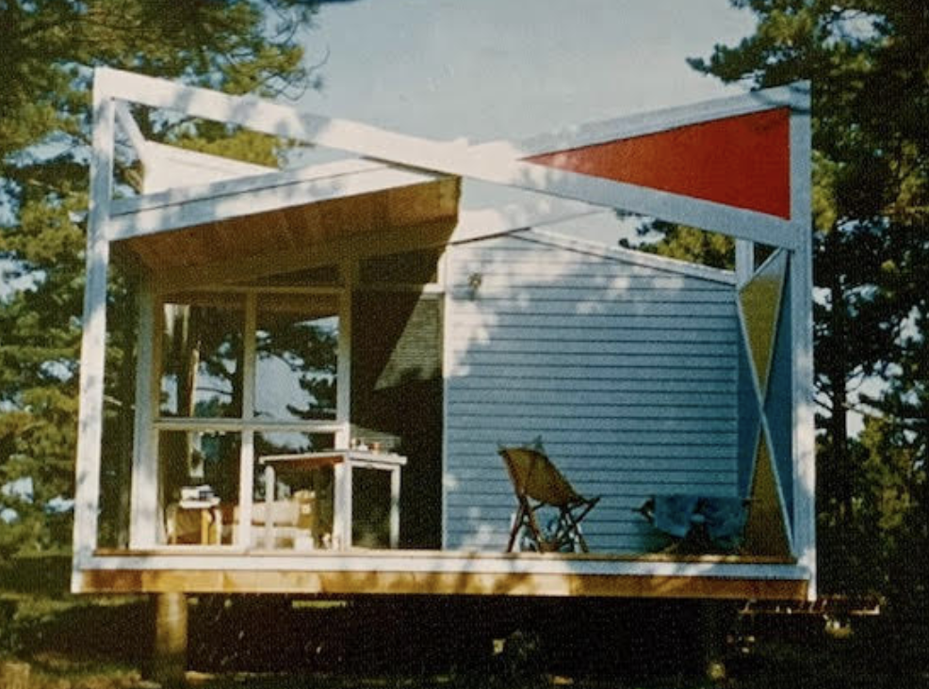
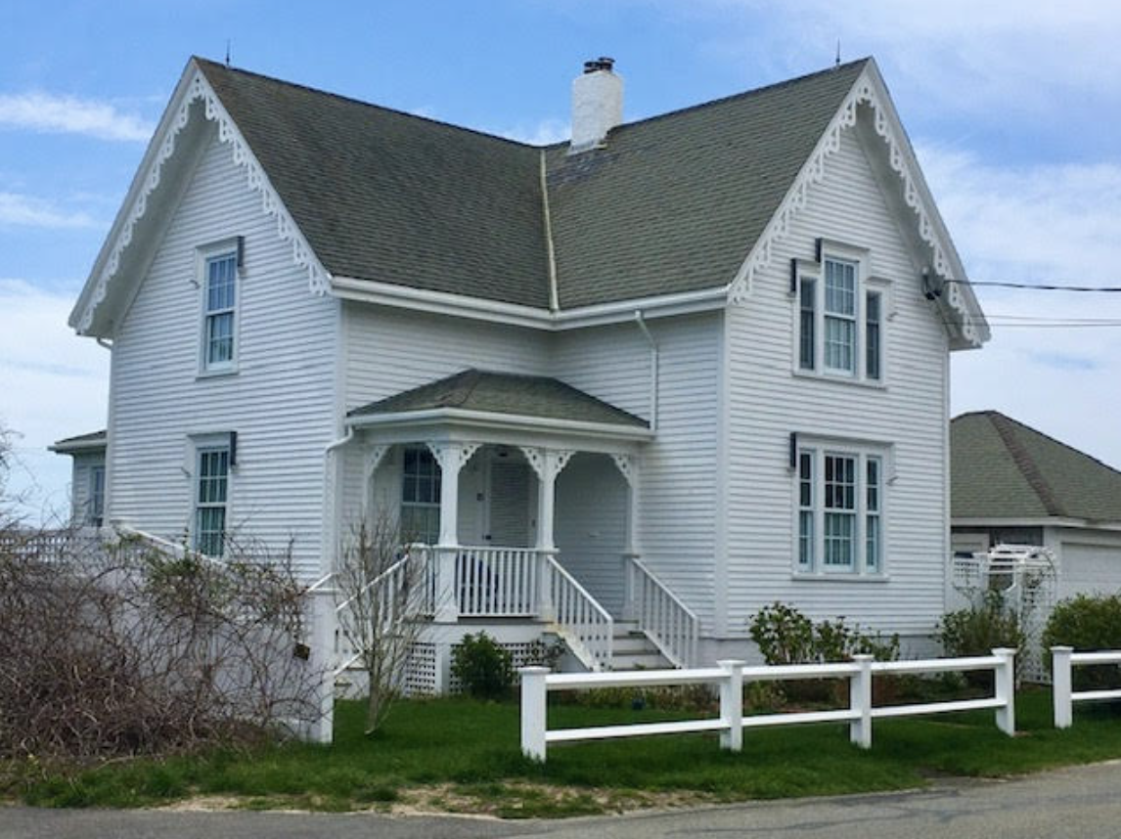
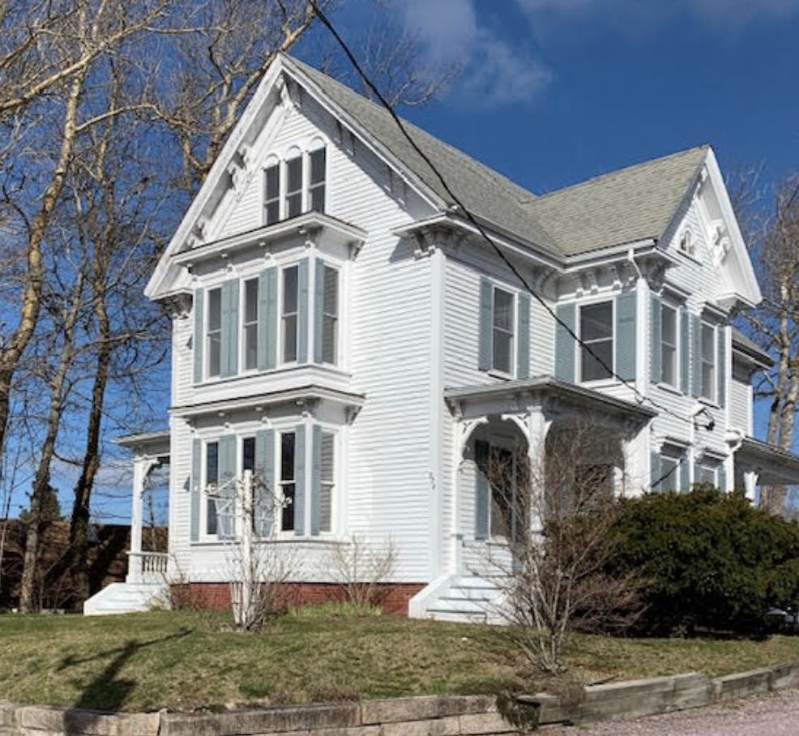
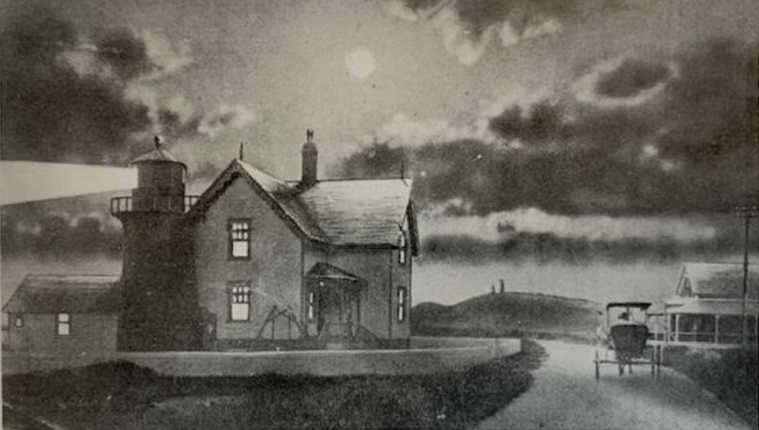
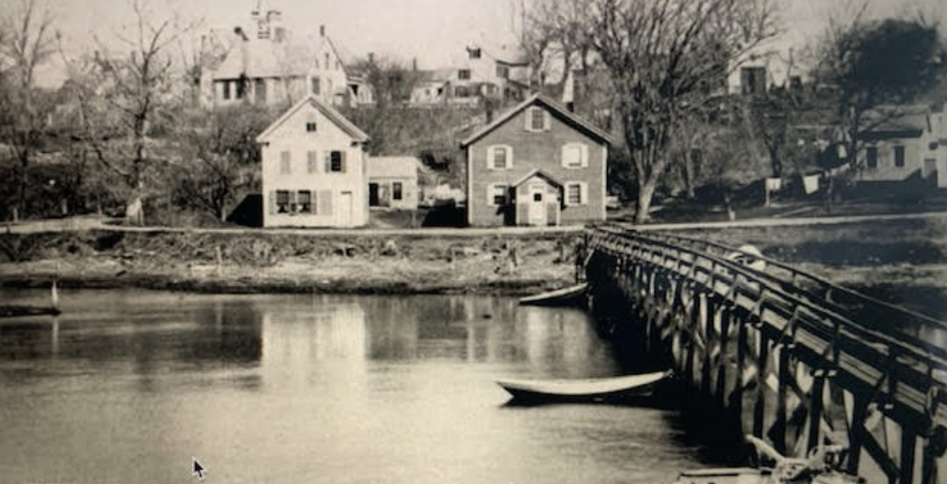
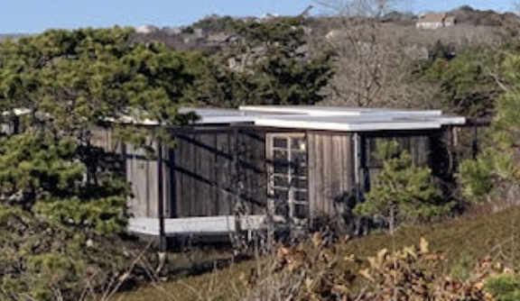
Questions?
For more information, please check the Historical Commission’s page on the Town of Wellfleet website
Contact us at wellfleethistoricalcommission@gmail.com

